Slide 1
Neural Network Compression
Azade Farshad ^{1,2}
Master Thesis Final Presentation
Advisor: Dr. Vasileios Belagiannis ²
Supervisor: Prof. Dr. Nassir Navab ¹
¹ Computer Aided Medical Procedures (CAMP),
Technische Universität München, Munich, Germany
² OSRAM GmbH, Munich, Germany

Slide 2
Introduction
Why compression?
  Hardware constraints
  Faster execution
  Goal: better performance, less memory and storage, deployment on devices with limited resources
Research directions
  Quantization and Binarization
  Parameter pruning and sharing
  Factorization
  Distillation (Dark knowledge)
Evaluation metrics
  Speed: FLOPs (Floating point operations)
  Memory: number of parameters
  Accuracy: classification

Slide 3
Network Compression - Quantization
32 bit → 16 bit, 8 bit, …
  Speed increase
  Memory usage decrease
Minimal loss of accuracy
Linear 8-bit quantization [1]
  Weights and biases normalized to fall in range [-128,127]
  ~3.5x memory reduction
Incremental Network Quantization [2]
  Weights: zero or different powers of two
  Three steps
    Weight partition
    Group-wise quantization
    Retraining
[1] Vanhoucke, Vincent, Andrew Senior, and Mark Z. Mao. "Improving the speed of neural networks on CPUs." NIPS Workshop, vol. 1, p. 4. 2011.
[2] A. Zhou, A. Yao, Y. Guo, L. Xu, and Y. Chen. Incremental network quantization: Towards lossless cnns with low precision weights. arXiv, 2017.

Slide 4
Network Compression - Binarization
1-bit precision
Speed increase due to less complex calculations and less space in memory
Binaryconnect [3]
  Binarized in FP and BP, Same precision in weight update
XNOR-Net [4]
  Binarized weights and operations
  High loss of accuracy
  Over 30x latency and memory usage reduction
Figure 1 (available at [5])
Figure 1. Binary networks [5]
[3] M. Courbariaux, Y. Bengio, and J.-P. David, “Binaryconnect: Training deep neural networks with binary weights during propagations,” NIPS, 2015.
[4] M. Rastegari, V. Ordonez, J. Redmon, and A. Farhadi, “Xnor-net: Imagenet classification using binary convolutional neural networks,” ECCV, 2016.
[5] https://ai.intel.com/accelerating-neural-networks-binary-arithmetic/

Slide 5
Network Compression - Pruning
Removal of redundant connections or neurons from the network
  Connections with low weight
  Neurons or filters with low impact
Learning weights and connections [6]
  Train connections => Prune => Retrain
Deep Compression [7]
  Pruning + Quantization + Huffman coding
  Minimal loss of accuracy, up to 35x compression in model size
Figure 1 (available at [8])
Figure 2. Pruning neurons or connections [8]
[6] S. Han, J. Pool, J. Tran, andW. Dally. Learning both weights and connections for efficient neural network. NIPS, 2015.
[7] S. Han, H. Mao, and W. J. Dally. Deep compression: Compressing deep neural networks with pruning, trained quantization and huffman coding. arXiv, 2015.
[8] https://www.oreilly.com/ideas/compressed-representations-in-the-age-of-big-data

Slide 6
Network Compression - Pruning and Parameter sharing
Pruning filters [9]
  Whole filters with connecting feature maps are pruned
  4.5x speed up with minimal loss of accuracy
HashedNets [10]
  Parameter sharing approach
  Low-cost hash functions
  Weights grouped in hash buckets
  Accuracy increase with 8x memory usage reduction
[9] H. Li, A. Kadav, I. Durdanovic, H. Samet, and H. P. Graf. Pruning filters for efficient convnets. arXiv, 2016.
[10] W. Chen, J. Wilson, S. Tyree, K. Weinberger, and Y. Chen. Compressing neural networks with the hashing trick. ICML, 2015.

Slide 7
Network Compression - Factorization
Low Rank Expansion [11]
  Basis filter set => Basis feature maps
  Final feature map = linear combination of basis feature maps
  Rank-1 basis filter => decomposed into a sequence of horizontal and vertical filters
  ~2.4x speedup, no performance drop
Figure 1 (available at [11])
Figure 3. Filter decomposition [11]
[11] M. Jaderberg, A. Vedaldi, and A. Zisserman, “Speeding up Convolutional Neural Networks with Low Rank Expansions,” BMVC, 2014.
[12] A. G. Howard et al., “Mobilenets: Efficient convolutional neural networks for mobile vision applications,” 2017.
[13] X. Zhang, X. Zhou, M. Lin, and J. Sun, “Shufflenet: An extremely efficient convolutional neural network for mobile devices,” arXiv, 2017.

Slide 8
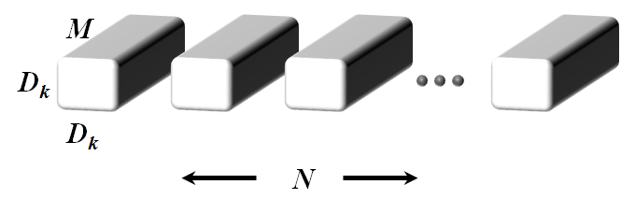
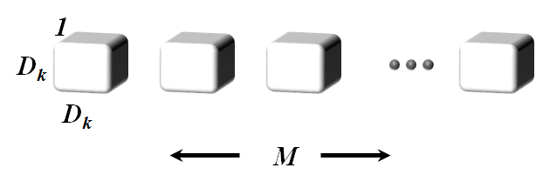
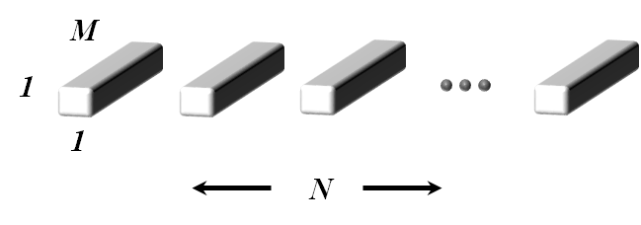
Network Compression - Factorization
MobileNets [12]
  Depthwise Separable Convolution
  Pointwise + Depthwise convolution
  70.2% accuracy on ImageNet
  ~7x less parameters and FLOPs
(b) Depthwise Convolutional Filters
(c) 1x1 Convolutional Filters called Pointwise Convolution in the context of Depthwise Separable Convolution
(a) Standard Convolution Filters
Figure 4. Depthwise convolution vs. Standard convolution [12]
[11] M. Jaderberg, A. Vedaldi, and A. Zisserman, “Speeding up Convolutional Neural Networks with Low Rank Expansions,” BMVC, 2014.
[12] A. G. Howard et al., “Mobilenets: Efficient convolutional neural networks for mobile vision applications, 2017.
[13] X. Zhang, X. Zhou, M. Lin, and J. Sun, “Shufflenet: An extremely efficient convolutional neural network for mobile devices,” arXiv, 2017.

Slide 9
Network Compression - Factorization
MobileNets [12]
  Depthwise Separable Convolution
  Pointwise + Depthwise convolution
  70.2% accuracy on ImageNet
  ~7x less parameters and FLOPs
ShuffleNet [13]
  Pointwise group convolutions
  Channel shuffle
  Outperforms MobileNets by 7.2%
  13x speed up while maintaining the accuracy of AlexNet
Figure 2 (available at [13])
Figure 5. ShuffleNet unit [13]
[11] M. Jaderberg, A. Vedaldi, and A. Zisserman, “Speeding up Convolutional Neural Networks with Low Rank Expansions,” BMVC, 2014.
[12] A. G. Howard et al., “Mobilenets: Efficient convolutional neural networks for mobile vision applications, 2017.
[13] X. Zhang, X. Zhou, M. Lin, and J. Sun, “Shufflenet: An extremely efficient convolutional neural network for mobile devices,” arXiv, 2017.

Slide 10
Network Compression - Distillation
L2 – Ba [14]
  L2 loss between teacher and student logits
  No labels required
Teacher Network
Student Network
L2 Loss
Figure 6. Teacher-Student model, L2
[14] J. Ba and R. Caruana, “Do deep nets really need to be deep?” In Advances in neural information processing systems, 2014, pp. 2654–2662.
[15] G. Hinton, O. Vinyals, and J. Dean, “Distilling the knowledge in a neural network,” ArXiv preprint arXiv:1503.02531, 2015.
[16] A. Romero, N. Ballas, S. E. Kahou, A. Chassang, C. Gatta, and Y. Bengio, “Fitnets: Hints for thin deep nets,” ArXiv preprint arXiv:1412.6550, 2015.

Slide 11
Network Compression - Distillation
L2 – Ba [14]
  L2 loss between teacher and student logits
  No labels required
Knowledge Distillation [15]
  Soft target: softmax cross entropy with teacher logits
  Hard target: softmax cross entropy with correct labels
Teacher Network
Student Network
labels
softmax
softmax
Figure 7. Teacher-Student model, KD
[14] J. Ba and R. Caruana, “Do deep nets really need to be deep?” In Advances in neural information processing systems, 2014, pp. 2654–2662.
[15] G. Hinton, O. Vinyals, and J. Dean, “Distilling the knowledge in a neural network,” ArXiv preprint arXiv:1503.02531, 2015.
[16] A. Romero, N. Ballas, S. E. Kahou, A. Chassang, C. Gatta, and Y. Bengio, “Fitnets: Hints for thin deep nets,” ArXiv preprint arXiv:1412.6550, 2015.

Slide 12
Network Compression - Distillation
L2 – Ba [14]
  L2 loss between teacher and student logits
  No labels required
Knowledge Distillation [15]
  Soft target: softmax cross entropy with teacher logits
  Hard target: softmax cross entropy with correct labels
FitNets [16]
  Knowledge Distillation with hints in the middle points of the network
  Student is deeper than the teacher
Teacher Network
Student Network
softmax
labels
softmax
softmax
Figure 8. Teacher-Student model, FitNets
[14] J. Ba and R. Caruana, “Do deep nets really need to be deep?” In Advances in neural information processing systems, 2014, pp. 2654–2662.
[15] G. Hinton, O. Vinyals, and J. Dean, “Distilling the knowledge in a neural network,” ArXiv preprint arXiv:1503.02531, 2015.
[16] A. Romero, N. Ballas, S. E. Kahou, A. Chassang, C. Gatta, and Y. Bengio, “Fitnets: Hints for thin deep nets,” ArXiv preprint arXiv:1412.6550, 2015.

Slide 13
Network Compression - Comparison
Method | Advantages | Disadvantages
Binarization & Quantization | Low latency and memory usage | High loss of accuracy
Pruning | Prevents overfitting, the accuracy can increase | Converges slower needs manual setup of layer sensitivity
Factorization | Can achieve state of the art results while decreasing the computation cost | Dependent on framework
Distillation | Applicable to all architectures Doesn’t change the network | KD needs labels => only applicable to classification task

Slide 14
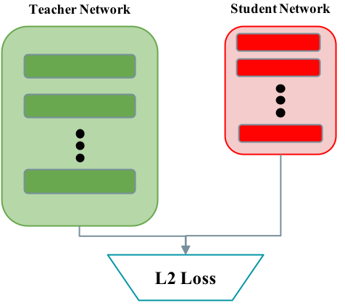
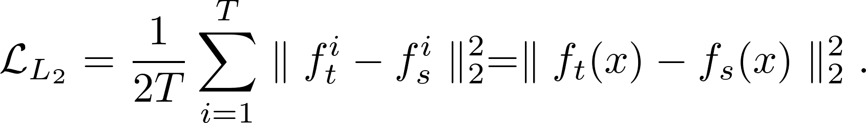
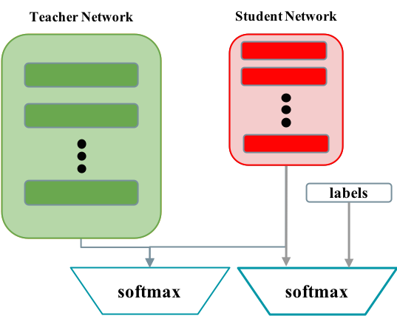
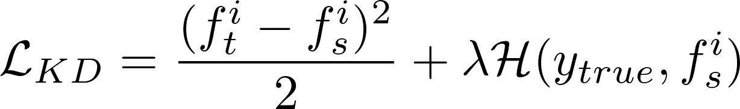
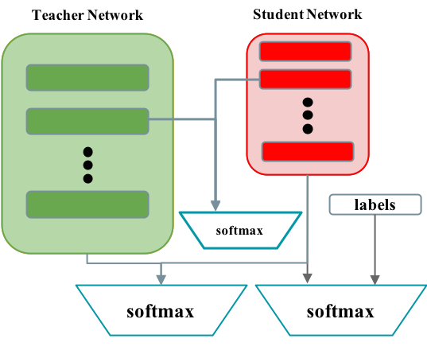
Distillation baseline objectives
L2 - Ba et al. :
Knowledge Distillation - Hinton et al. :
FitNets - Romero et al. :

Slide 15
Adversarial Network Compression
Network Compression using Adversarial training + Distillation
Motivation: Generative Adversarial Networks [17]
Goal: improving performance of distillation
Teacher Network
Student Network
Adversarial Training
Figure 9. Adversarial Network Compression
[17] I. Goodfellow, J. Pouget-Abadie, M. Mirza, B. Xu, D.Warde-Farley, S. Ozair, A. Courville, and Y. Bengio. Generative adversarial nets. In Advances in neural information processing systems, pages 2672–2680, 2014.

Slide 16
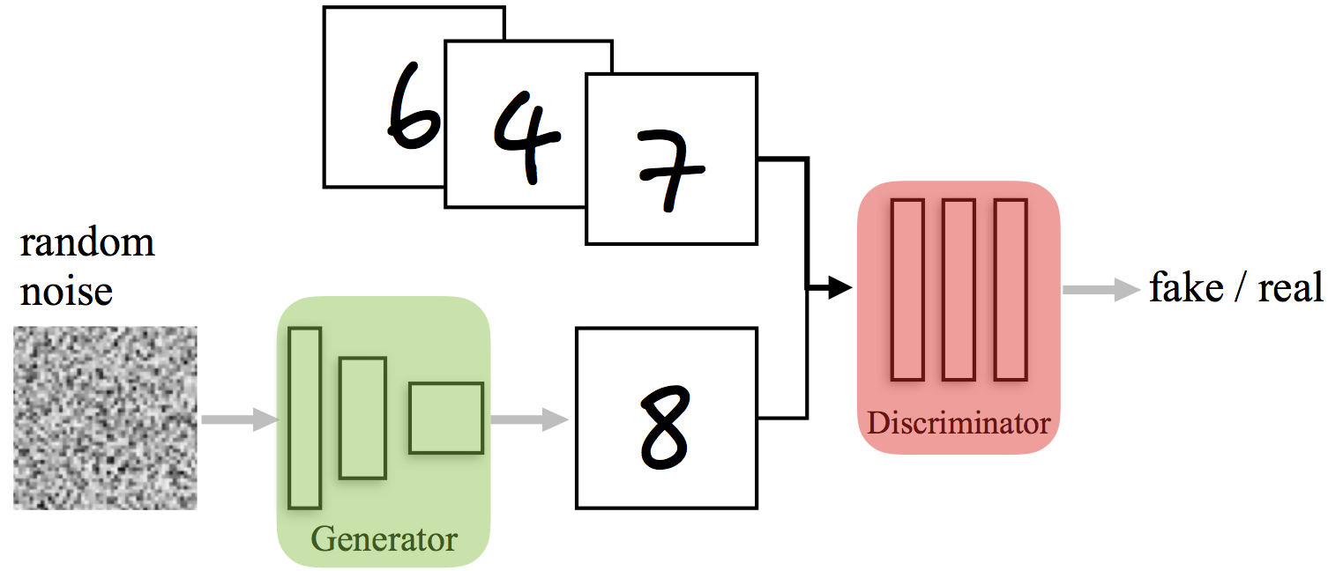
Generative Adversarial Networks
Goal: generating real images
Two networks competing
  Generator: fake images
    Input: random noise
    Output: images
  Discriminator
    Input: image samples
    Output: real or fake?
Learning Objective
Conditional GAN [18]
  The input can be conditioned on labels or other images
Figure 10. Generative Adversarial Network
[17] I. Goodfellow, J. Pouget-Abadie, M. Mirza, B. Xu, D.Warde-Farley, S. Ozair, A. Courville, and Y. Bengio. Generative adversarial nets. In Advances in neural information processing systems, pages 2672–2680, 2014.
[18] M. Mirza and S. Osindero, “Conditional generative adversarial nets,” ArXiv preprint arXiv:1411.1784, 2014.

Slide 17
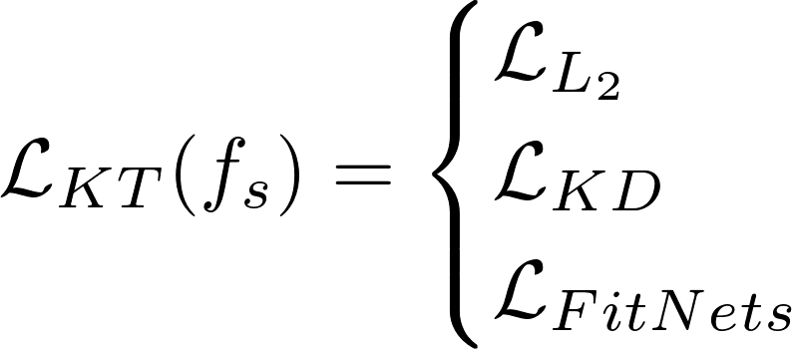
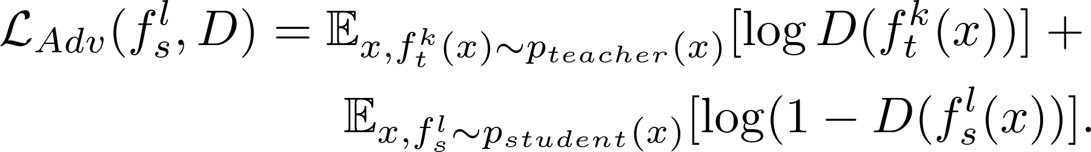
Adversarial Network Compression
Three components
  Student: Generator, fake
  Teacher: real
  Discriminator: Student or Teacher?
Learning objectives
  Knowledge transfer: L2 loss between teacher and student
  Adversarial loss
  Full objective
Teacher Network
Student Network
Dropout
Discriminator
L2
Figure 9. Adversarial Network Compression

Slide 18
Adversarial Network Compression
Network structure
  Teacher (e.g. ResNet-164)
    Input: image sample
    Outputs: logits, features
  Student: (e.g. ResNet-20)
    Input: image sample
    Outputs: logits, features
  Discriminator: 3 layer FCN
    Input: student, teacher, adversary features
      Adversary (student) + dropout
      Similar to noise input from [19]
    Output: Teacher/Student
  L2 loss
    Input: student and teacher logits
Teacher Network
Student Network
Dropout
Discriminator
L2
Figure 9. Adversarial Network Compression
[19] Arjovsky M, Bottou L. Towards principled methods for training generative adversarial networks. arXiv preprint arXiv:1701.04862. 2017 Jan 17..

Slide 19
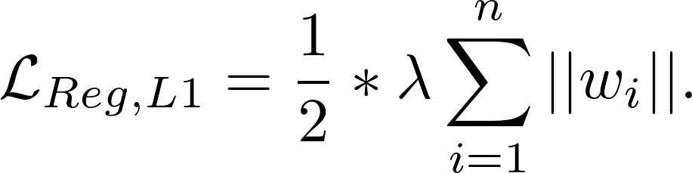
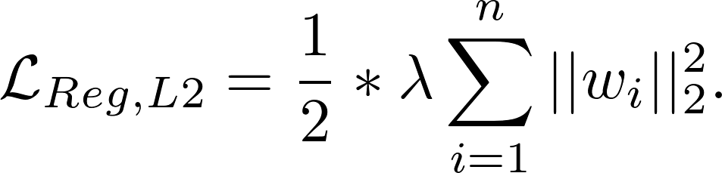
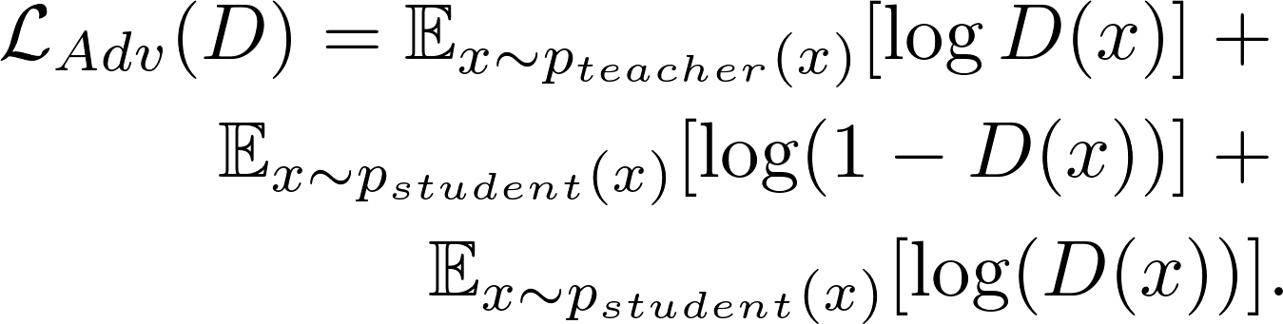
Discriminator regularization
Discriminator gets too strong due to low input dimensionality
Regularization Methods:
  L1/L2 regularization [20]
  Proposed regularization: Updating discriminator with adversary samples
    Dynamic, dependent on student strength
[20] A. Y. Ng, “Feature selection, l1 vs. l2 regularization, and rotational invariance,” in Proceedings of the Twenty-first International Conference on Machine Learning, ser. ICML , 2004.

Slide 20
Experiments
Six datasets:
  MNIST, Fashion-MNIST, CIFAR-10, CIFAR-100, SVHN, ImageNet
Network architectures:
  ResNet [21]
  Network in Network [22]
  LeNet-4 [23]
Evaluation metrics:
  Classification error
  Network parameters
[21] K. He, X. Zhang, S. Ren, and J. Sun, “Identity mappings in deep residual networks,” in European Conference on Computer Vision, Springer, 2016.
[22] M. Lin, Q. Chen, and S. Yan, “Network in network,” ArXiv preprint arXiv:1312.4400, 2013.
[23] Y. LeCun, B. E. Boser, J. S. Denker, D. Henderson, R. E. Howard,W. E. Hubbard, and L. D. Jackel, “Handwritten digit recognition with a back-propagation network,” in NIPS 1990.

Slide 21
Experiments - Continued
Experiments:
  Regularization methods
  Discriminator architectures
  Discriminator input variations
  Comparison between different network compression methods
Training method:
  Pretrained teacher using labels
  Random initialization of student and discriminator

Slide 22
Evaluation - Discriminator architecture
Teacher and Student networks, dataset, regularization method and input to discriminator: Fixed
Discriminator architecture: Varied
Architecture | Top-1 Error [%] on CIFAR-100
128fc - 256fc - 128fc | 32.45
64fc - 128fc - 256fc | 32.78
256fc - 256fc | 32.82
256fc - 128fc - 64fc | 33.05
500fc - 500fc | 33.28
256fc - 256fc - 64fc | 33.46
128conv - 256conv | 33.68
128fc - 128fc - 128fc | 33.72
64fc - 64fc | 33.51
64fc - 128fc - 128fc - 64fc | 33.09
* fc: fully connected layer
* conv: convolutional layer

Slide 23
Evaluation - Regularization method
Networks, discriminator architecture and input to discriminator: Fixed
Regularization method: Varied
Our proposed regularization: Updating discriminator with adversarial samples
Dataset | Teacher | Student | Top-1 Error [%]
 |  |  | w/o regularization | L1 | L2 | Ours
CIFAR-10 | ResNet-164 | ResNet-20 | 10.07 | 8.19 | 8.16 | 8.08
CIFAR-100 | ResNet-164 | ResNet-20 | 34.10 | 33.36 | 33.02 | 32.45
SVHN | ResNet-164 | ResNet-20 | 3.73 | 3.67 | 3.68 | 3.66
Fashion-MNIST | NiN | LeNet-4 | 9.62 | 8.91 | 8.75 | 8.61
MNIST | NiN | LeNet-4 | 1.14 | 1.04 | 1.03 | 0.96

Slide 24
Evaluation - Different inputs to discriminator
Fixed network, discriminator architecture
Input to discriminator
  Logits, Logits + dropout, Features, Features + dropout
Dataset | Teacher | Student | Top-1 Error [%]
 |  |  | Supervised Teacher | Supervised Student | logits | logits + dropout | features | features + dropout
CIFAR-100 | ResNet-164 | ResNet-20 | 27.76 | 33.36 | 33.9 | 33.41 | 33.40 | 32.45
SVHN | ResNet-164 | ResNet-20 | 3.98 | 4.20 | 3.74 | 3.81 | 3.74 | 3.66
Fashion-MNIST | NiN | LeNet-4 | 7.98 | 8.77 | 8.90 | 8.84 | 8.86 | 8.61
ImageNet | ResNet-152 | ResNet-18 | 27.63 | 43.33 | - | - | 33.31 | 32.89
ImageNet | ResNet-152 | ResNet-50 | 27.63 | 30.30 | - | - | - | 27.86

Slide 25
Evaluation - Comparison between compression methods
Evaluation on CIFAR-10 and CIFAR-100
Model (CIFAR-10) | Error [%] | Parameters
L2 - Ba et al. [14] | 9.07 | 0.27M
KD - Hinton et al. [15] | 8.88 | 0.27M
Quantization [24] | 8.87 | 0.27M
FitNets [16] | 8.39 | 2.5M
BinaryConnect [3] | 8.27 | 15.20M
Yim et al. [25] | 11.30 | -
Adversarial Compression | 8.08 | 0.27M
Model (CIFAR-100) | Error [%] | Parameters
L2 - Ba et al. [14] | 32.79 | 0.27M
KD - Hinton et al. [15] | 33.34 | 0.27M
FitNets [16] | 35.04 | 2.5M
Yim et al. [25] | 36.67 | -
Adversarial Compression | 32.45 | 0.27M
[24] C. Zhu, S. Han, H. Mao, and W. J. Dally, “Trained ternary quantization,” ArXiv preprint arXiv:1612.01064, 2016.
[25] J. Yim, D. Joo, J. Bae, and J. Kim, “A gift from knowledge distillation: Fast optimization, network minimization and transfer learning,” in 2017 IEEE Conference on Computer Vision and Pattern Recognition (CVPR), Jul. 2017.

Slide 26
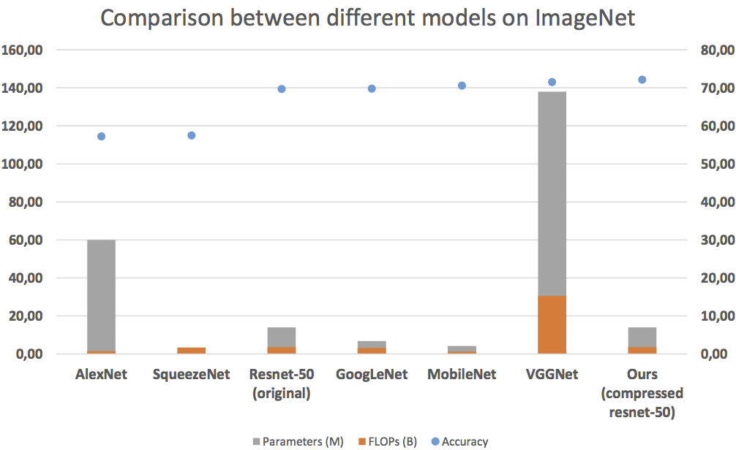
Comparison to other well-known networks on ImageNet

Slide 27
Conclusion
Adversarial compression achieves better performance than similar approaches without need of labels
Discriminator regularization is needed for best performance
Dropout on adversary improves performance by preventing trivial solutions
Adversarial compression decreases the number of teacher parameters significantly with minimal loss of accuracy
There is a trade-off between speed and accuracy

Slide 28
Thank you for your attention!
Questions?

