Slide 1
Your Project Title Here
Lab Course / Praktikum: Winter Semester 2012/2013
Project Management and Software Development for Medical Applications
Your Name Here
Supervised by: Supervisor Name Here
Computer Aided Medical Procedures (CAMP),
Technische Universität München

Slide 2
Introduction
Provide short background about the work and explain the goal of this project
Motivate the audience and tell why this work is important
Tell us about previous works in this direction (if there is any, try to find out!)
And yes, you should fit all these in one slide! So pick the highlights.

Slide 3
Functional Requirements
The final software should meet the following constraints
Host operating system
Memory and performance time constraints
Graphical user interface constraints (if applicable)
Basic architectural considerations such as web-based
Development language and IDE
Feel free to add more items based on your project here as your supervisors told you
Again all this just in one slide!

Slide 4
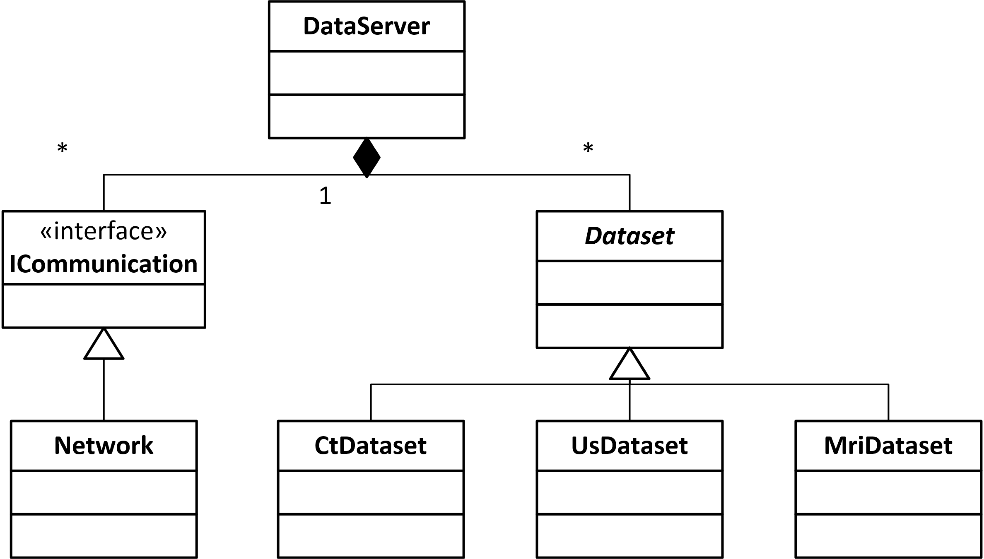
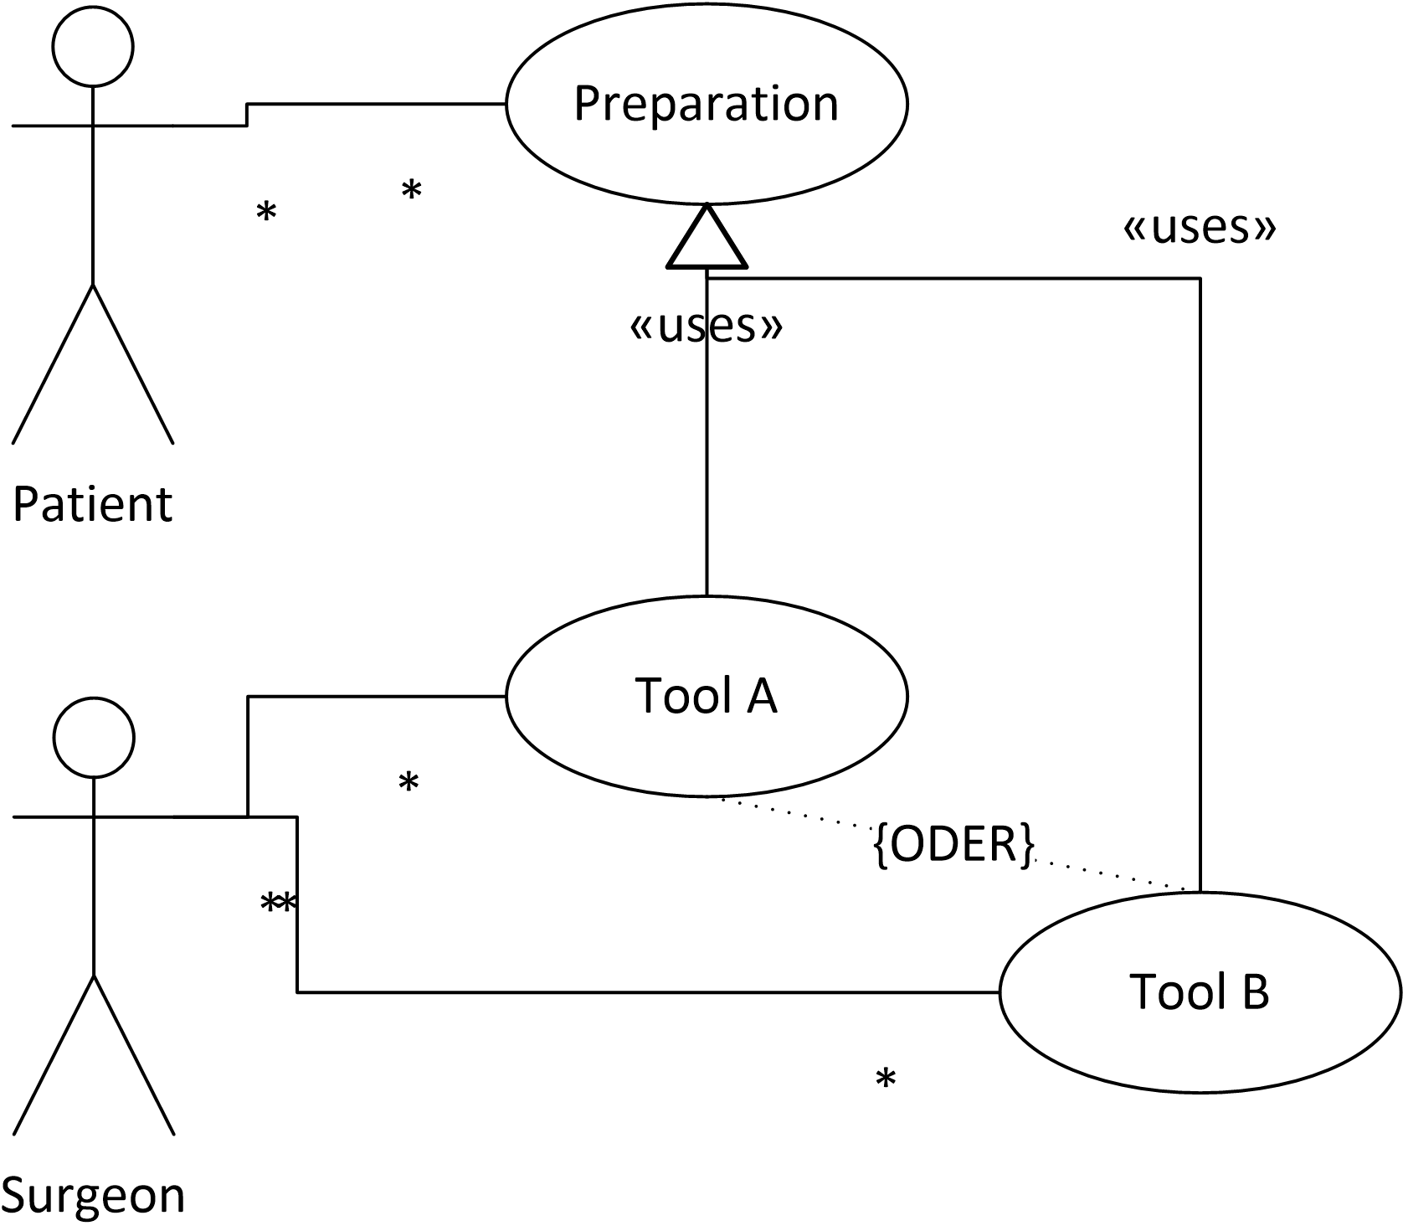
UML diagram
Put your use diagrams in here
You can add one more page for another diagram

Slide 5
Resources and time constraints
Resources
  Define what kind of resources is needed in your project.
  For each item also mention who suppose to provide this resource.
  For each let us know if you have it or still waiting for it.
Timeline
  Plan you projects and define some mile stones.
  In one sentence explain your mile stones’ achievements.

Slide 6
Questions

