Slide 1
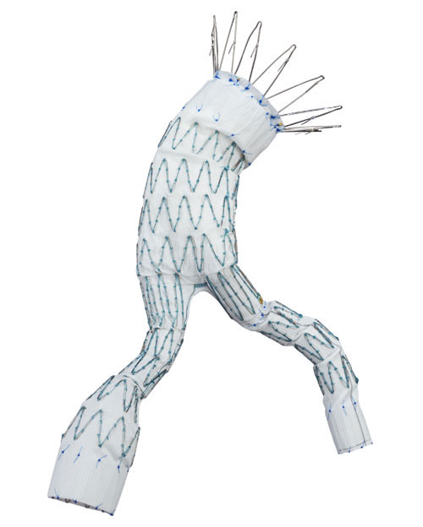
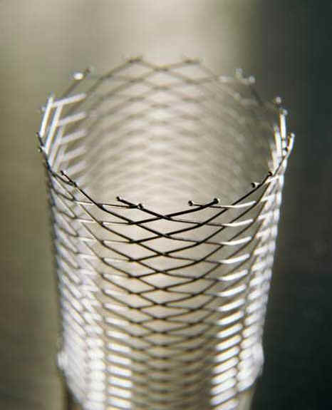
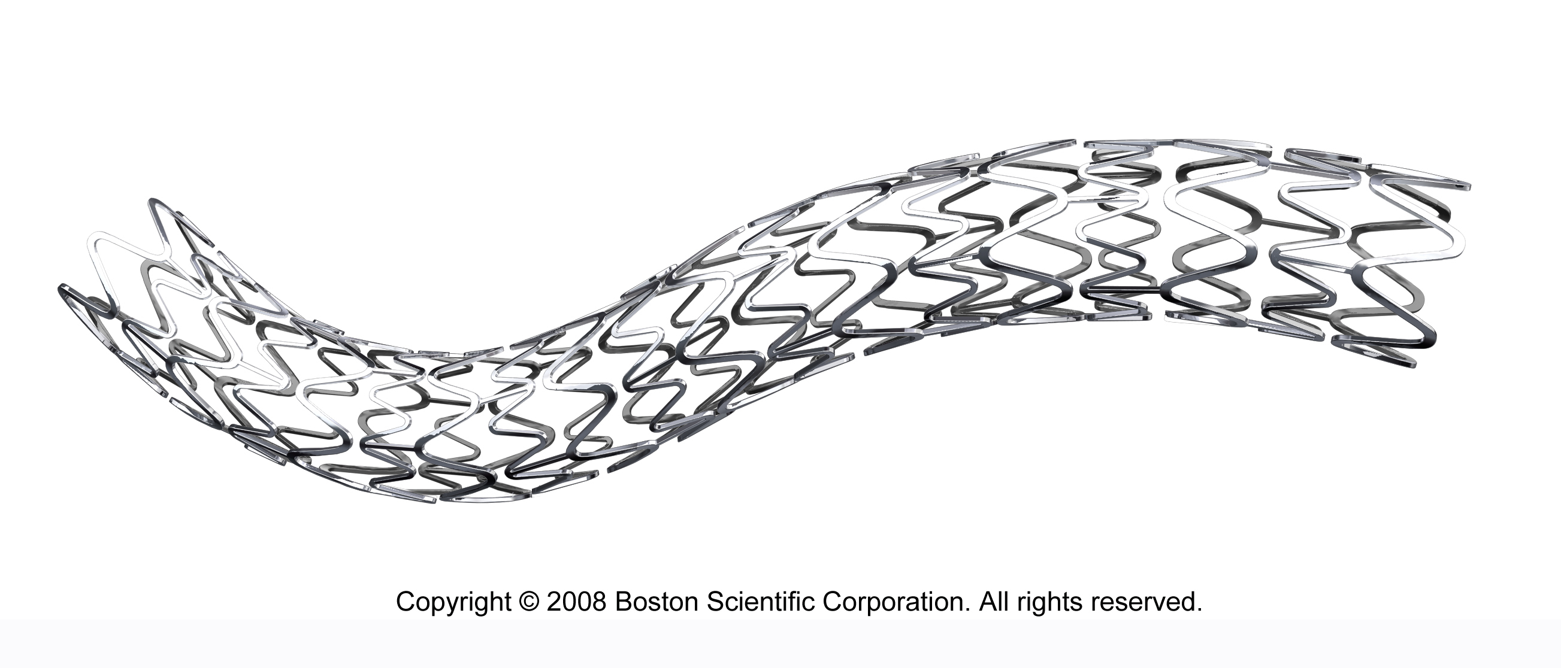
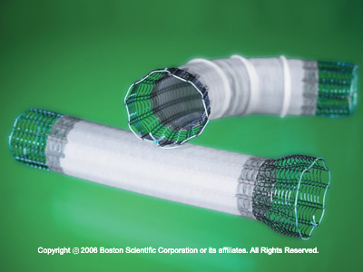
New Methods for Computer Assisted Stenting
Advanced Seminar Course:
Stefanie Demirci

Slide 2
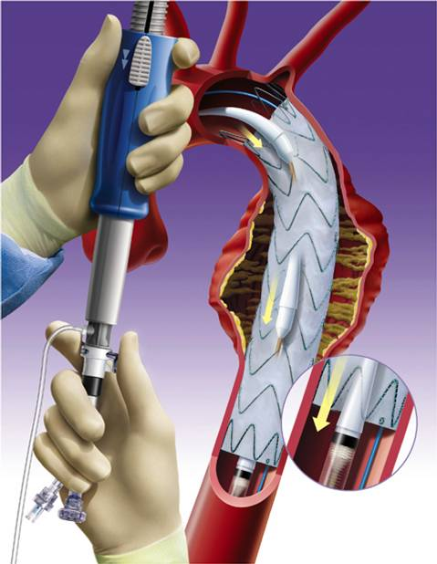
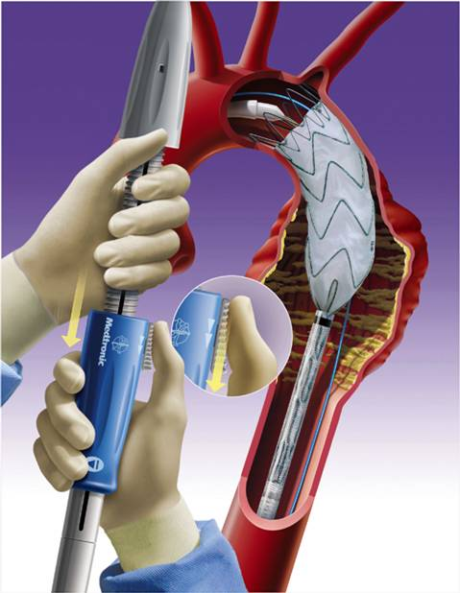
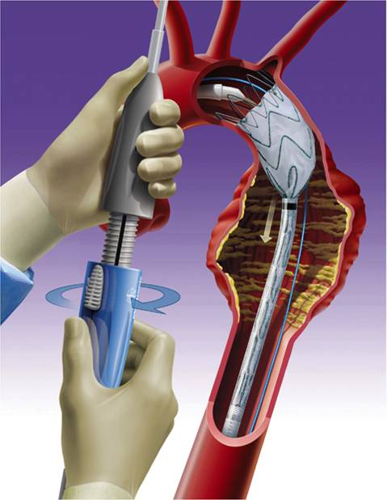
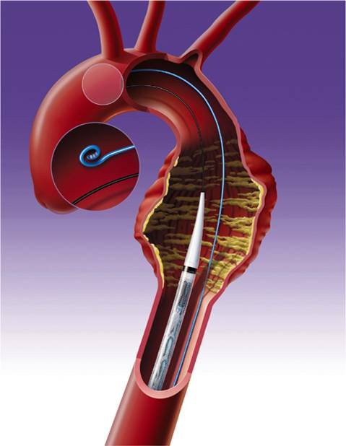
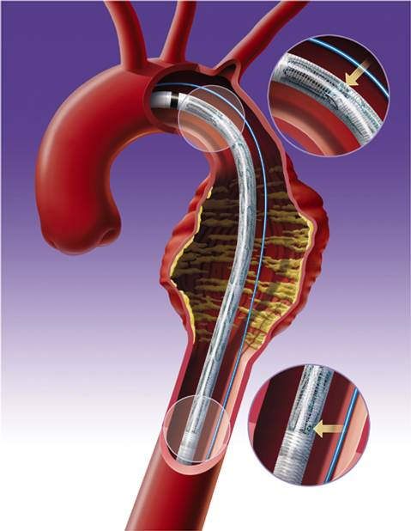
Medical Background

Slide 3
Medical Procedure
Diagnosis
&
Treatment Planning
Intervention
Follow-Up
Examinations
Tasks:
Choice of appropriate treatment
Measure prosthesis’ parameters
Choice of appropriate configuration
Imaging:
CT Angiography
2D Angiography
Navigation of guide wire and catheter
Exact placement of prosthesis
Angiography/Fluoroscopy
DSA
3D Angiography
Endoleakage detection
Check size of aneurysm
Observation of stent movement and aorta deformation
DSA
CT Angiography

Slide 4
Medical Background
Head (cranial stents)
Abdomen (aortic stents)
Stenting Procedures
Heart (coronary stents)
…

Slide 5
Seminar Topics
Virtual Stenting (2 presentations)
Navigated Stenting (2 presentation)
Analysis of Stent Effects (5 presentations)
Intra-op. Image Enhancement (3 presentation)
Validation for Computer Assisted Stenting (2 presentation)
Pre-op. Planning Support (1 presentation)

Slide 6
General Information
Presentation:
20 min. presentation and 10 min questions
Official CAMP templates for PowerPoint and Latex available on website
Essay:
8 pages without abstract, images and bibliography
has to be submitted one week after the presentation
Latex template available on website
Both the presentation and the report have to be done in English.

Slide 7
General Information
Grading system:
40% presentation (quality of knowledge transfer)
40% essay (language, structuring, citations)
20% participation (attendance and contribution)
how well is background knowledge prepared and presented ?
is the audience able to follow and come up with questions/comments ?
how well is the topic reported (language, structuring) ?
how much effort made the presenter for literature search ?
is the student able to contribute to discussion ?

Slide 8
General Information
Course Regulations:
announce absence via email before start of class
absence without excuse on day of own presentation ➔ Fail
absence without excuse on any other class ➔ Fail in participation
repetition of presentations possible (eventually within CAMP Oberseminar)
essay needs to be submitted one week after initial presentation date
Every single student is required to think of at least one questions for each presentation

Slide 9
Paper Assignment
Slides will be available on seminar webpage
Also list of topics
Send your favorite topic to
stefanie.demirci@tum.de
deadline is March 31, 2013
literature will be sent out on April 1, 2013

Slide 10
Questions ?

