Slide 1
Barcode Reading
Team : Maxime Arbisa
Zijun SHEN
Benjamin Busam
Ali Fatemi
Vítor Bueno
November 22nd 2013

Slide 2
Outlines
Aim : How to read a barcode out of a picture ?
Main tasks :
1st part : barcode detection
2nd part : barcode rotation
3rd part : bars reading
Maxime & Zijun
Benni
Vitor & Ali

Slide 3
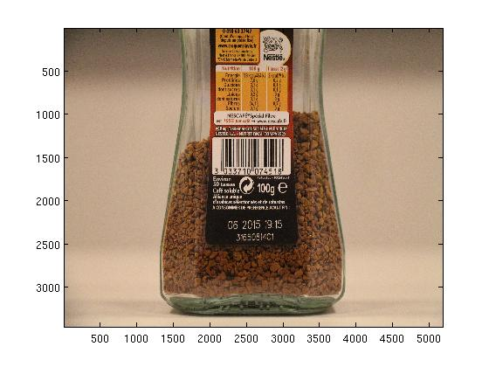
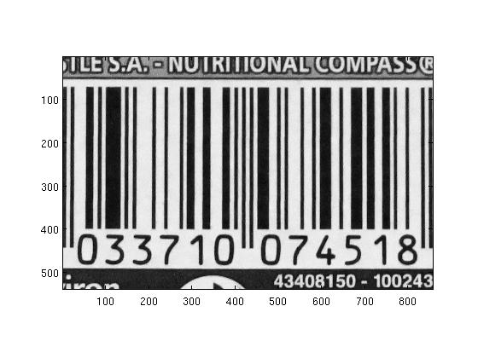
1st part : barcode detection
Aim : Find the barcode within the original picture
Input : original picture
Output : image of the barcode excerpted from the picture

Slide 4
How ?
Straight line detection
Fourier Transform
Inverse fourier tranform
Barcode found !
Thresholding
Closing

Slide 5
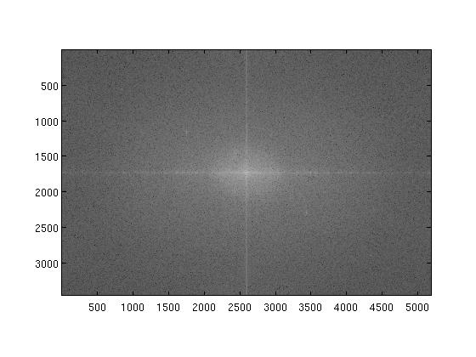
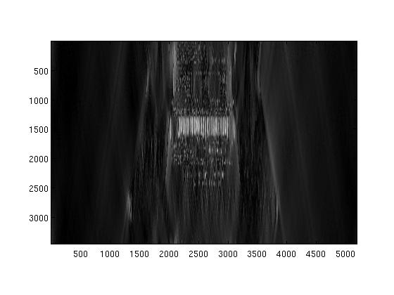
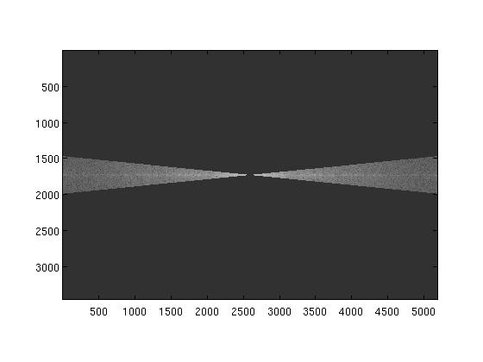
Fourier Transform

Slide 6
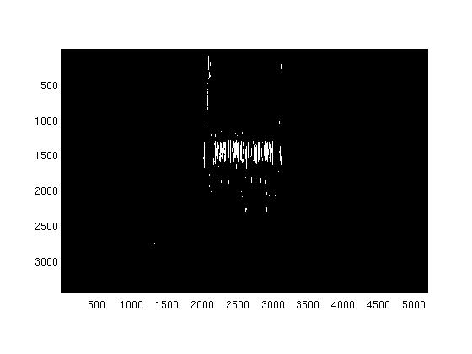
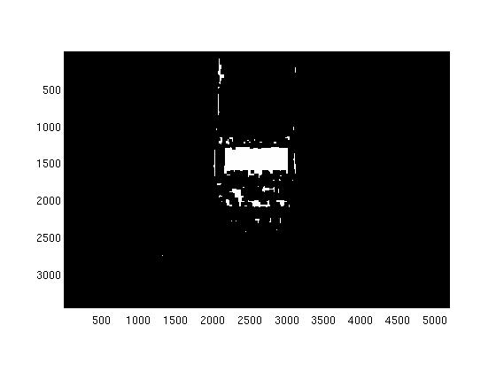
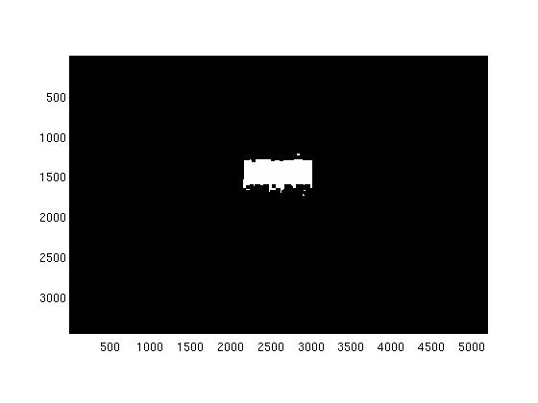
Mathematical Morphology

Slide 7
Advantages & Limits
Advantages :
1) It works
2) Barcode not necessarily horizontal
Limits
1) Only one barcode detection
2) Fourier transform :
- there must not be strong transitions other than the code bar
3) Mathematical morphology :
- we must know the size of the barcode to adapt our mask

Slide 8
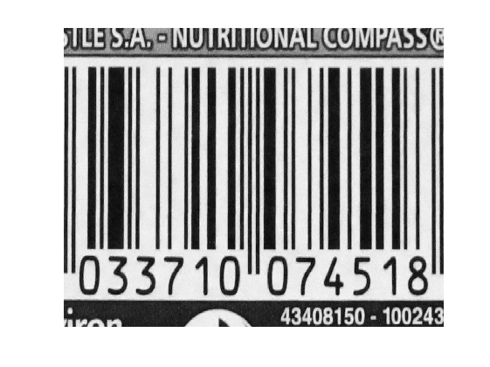
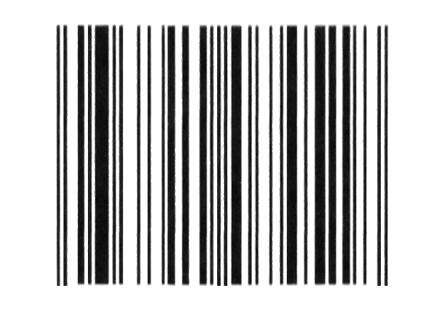
Rectification of barcode

Slide 9

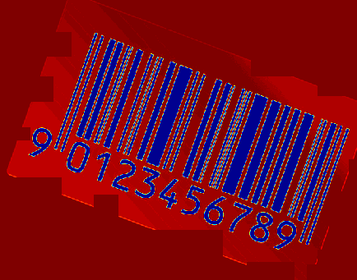
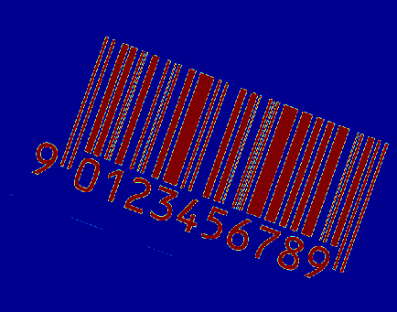
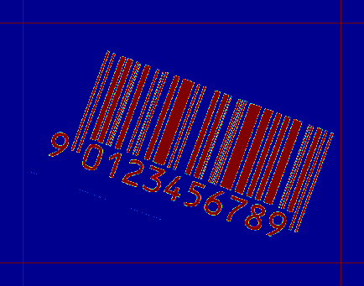
Preprocessing
Light
Extend

Slide 10


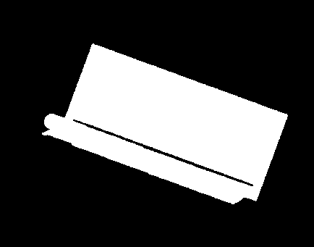

Morphological Operations
S.E.
Blur
Close
α
Open

Slide 11
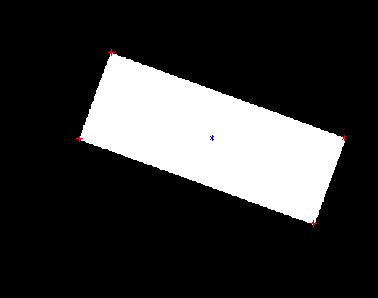

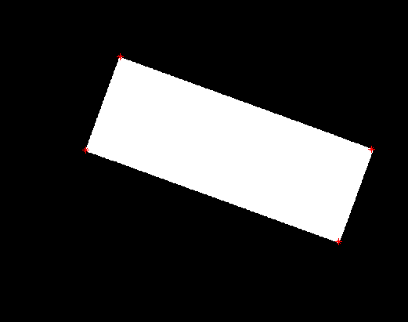
Corner Detection
2
1
3
4

Slide 12
Calculate Homography
H

Slide 13
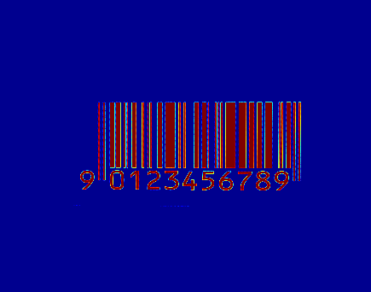

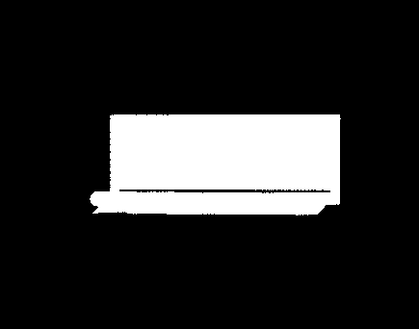
Rectification
H

Slide 14


Postprocessing
Rot?
Diff.
Close

Slide 15

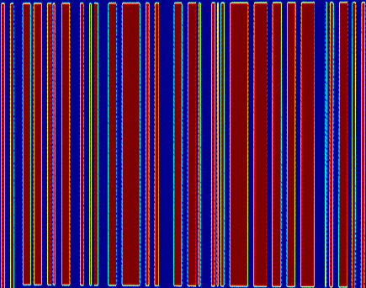
Postprocessing
Bounds?

Slide 16
Third Part – Barcode Decoding
- Binary Image
- Blocking binary image
- Finding the position of the first and the last bar
- Calculating the unitbar (thickness of the smallest bar)
- Comparing the thickness of bars with the unitbar
- Decoding by searching in the table of codes

Slide 17
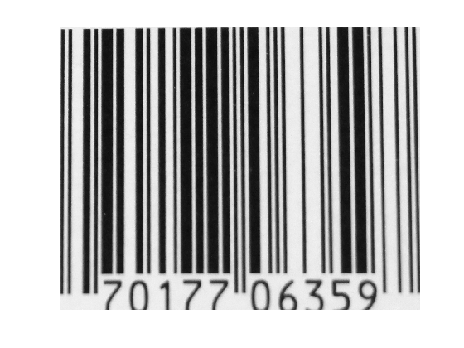
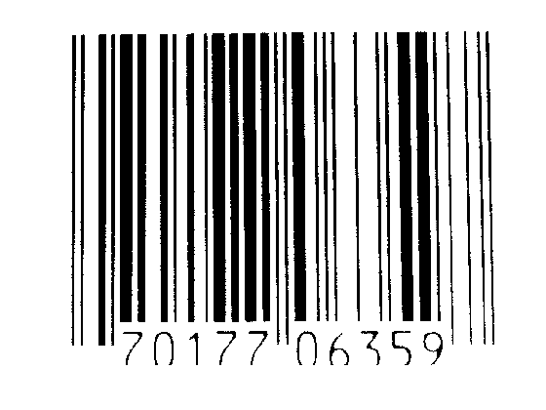
Binary Image
Thresholding process

Slide 18

Blocking
Thresholding process

Slide 19
First bar and last bar
Thresholing process
- All the barcodes include 95 unitbars (the width of the thinnest bar in each barcode)

Slide 20
Calculating the unitbar
Thresholing process
- Finding the difference of the position of the first and last bar and dividing it by 95

Slide 21
- Comparing the thickness of bars with the unitbar
- Decoding by searching in the table of codes
0 | 3211
1 | 2221
2 | 2122
3 | 1411
4 | 2311
5 | 1231
6 | 1114
7 | 1312
8 | 1213
9 | 3112

Slide 22

Thank you !
Any questions ?

