Slide 1
Computing the Stereo Matching Cost with a Convolutional Neural Network
Markus Herb
Seminar Recent Trends in 3D Computer Vision
Supervisor: Benjamin Busam
Žbontar & LeCun, CVPR 2015

Slide 2
Contents
Stereo Vision
Background
State-of-the-Art
  Stereo Pipeline
  Matching Cost Computation
MC-CNN
  Network Architecture
  Network Training & Prediction
Results
Conclusion & Future Work

Slide 3
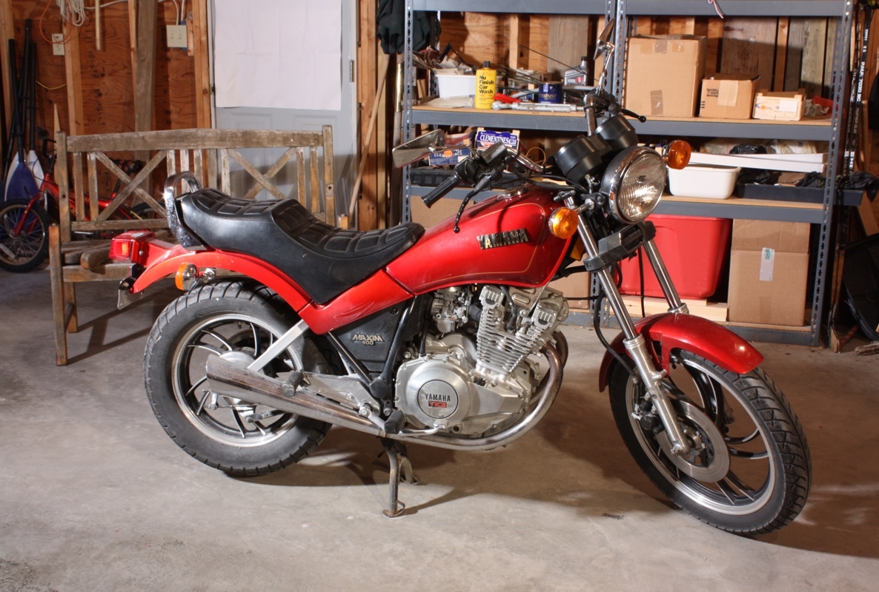
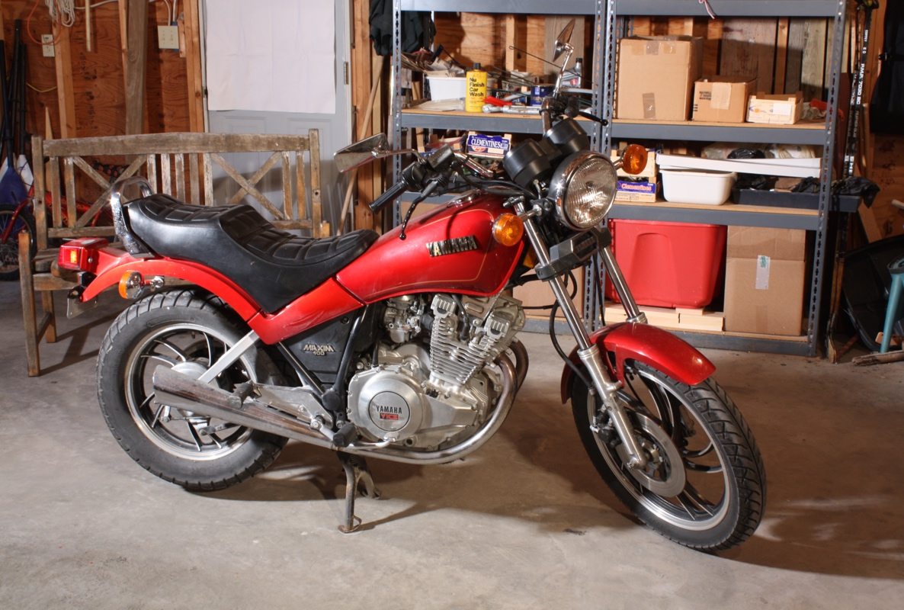
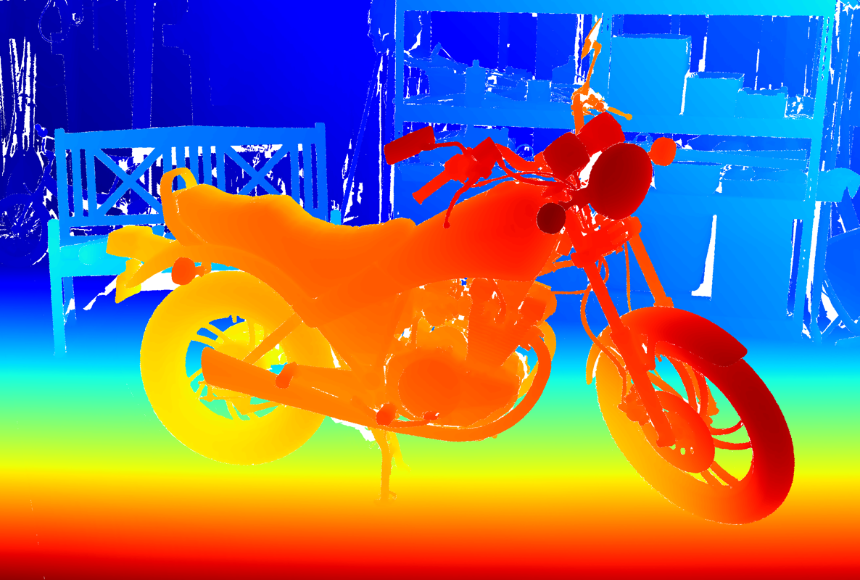
Stereo Vision
Left View
Right View
Capture scene with two cameras from different viewpoints
Reconstruct 3D depth information from input images alone
Cheap, passive sensors only
Sophisticated processing needed
Large number of applications in robotics, medical, …
Disparity Map
Images from Middlebury 2014 Dataset [3]

Slide 4
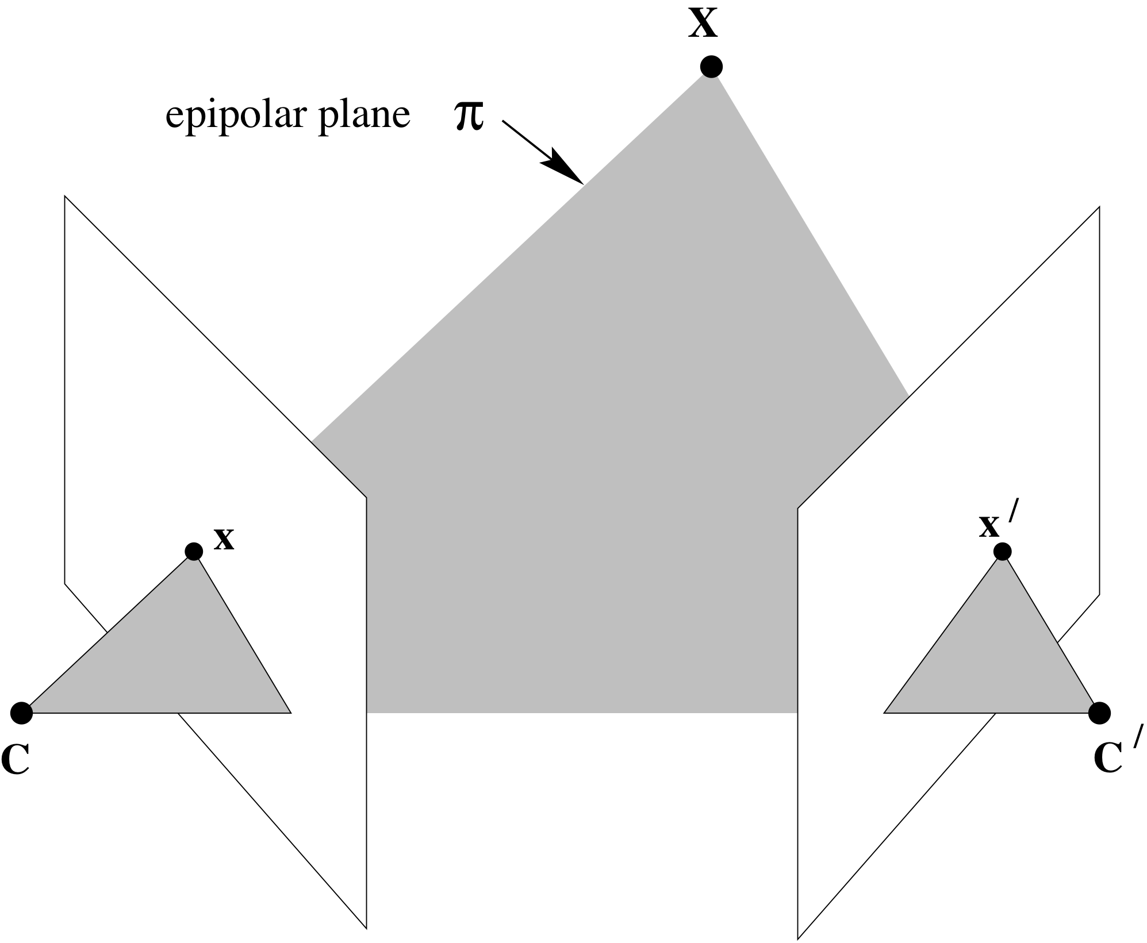
Background: Epipolar Geometry
Epipolar line l
Epipolar line l’
Images by Hartley et al. [4]

Slide 5
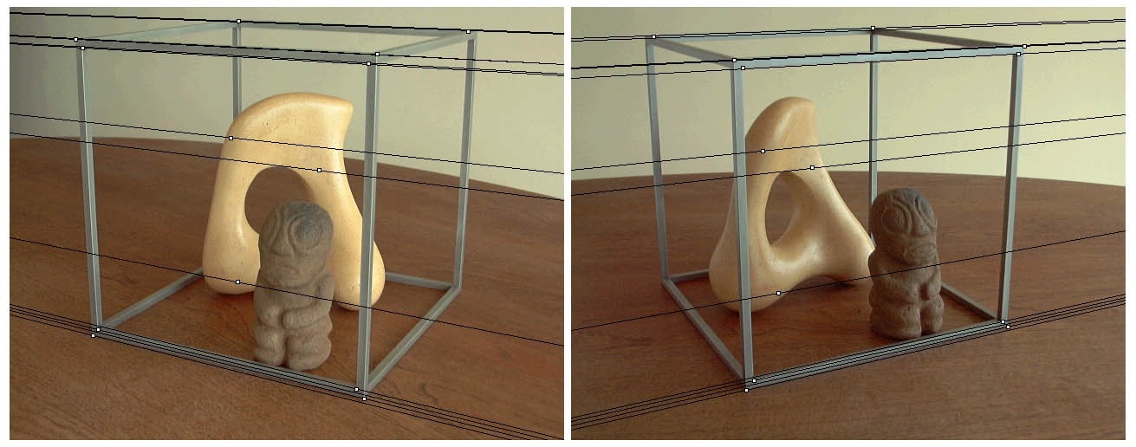
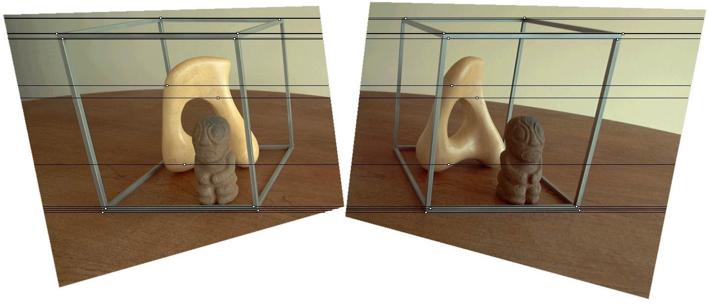
Background: Rectification and Disparity
Original Images
Epipolar lines in arbitrary directions
Perform Rectification for easier matching
Rectified Images
All Epipolar lines horizontal and aligned
Matches defined by horizontal offset (Disparity)
Depth inversely proportional to Disparity
Images by Loop et al. [5]

Slide 6
State-of-the-Art: Stereo Pipeline
Matching Cost Computation
Cost Aggregation
Disparity Computation
Disparity Refinement
Compute Matching cost at each pixel (x,y) for each disparity d
Disparity Space Image (DSI):
Store cost in 3D cost volume C(x,y,d)
Aggregate and optimize cost in DSI
Compute and refine disparity map D(x,y) from DSI
Taxonomy according to Scharstein et al. [6]

Slide 7
State-of-the-Art: Matching Cost Computation
Absolute Differences (AD) / Squared Differences (SD)
Normalized Cross Correlation (NCC) (e.g. [7])
Census Transform [8]
  Binary Feature vector of intensity comparisons
  Cost given by Hamming distance
Mutual Information (MI) [9]
  Cost based on joint entropy of image intensities
Combined Costs, e.g. AD + Census [10]

Slide 8
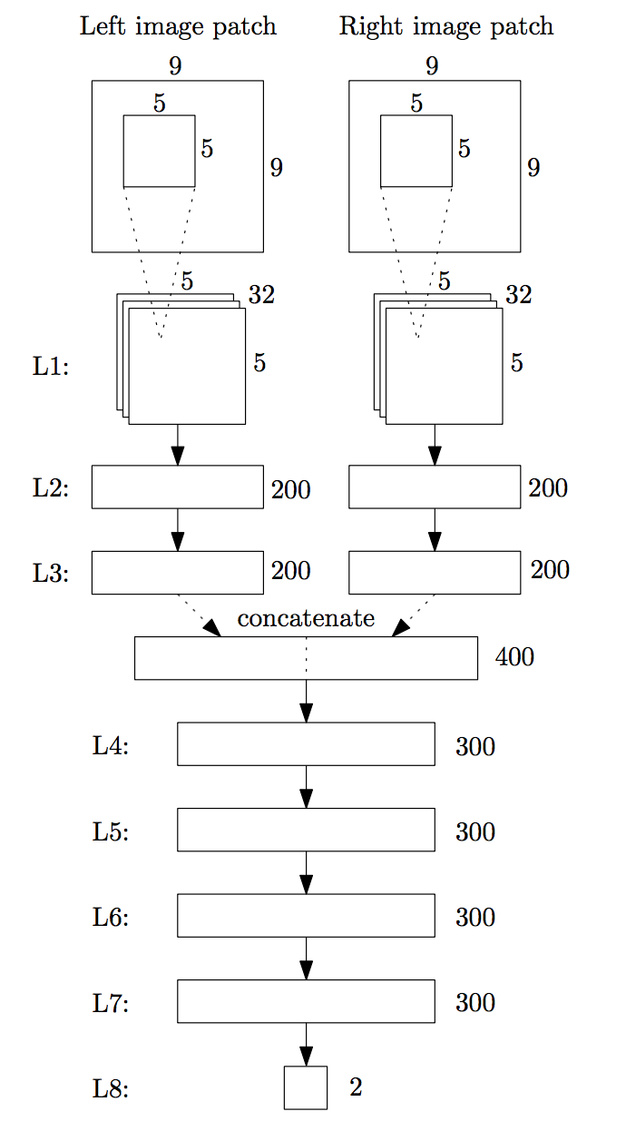
MC-CNN: Network Architecture
Network computes patch-similarity
Input patches from left and right image at fixed disparity
Parallel paths for both patches with tied weights
ReLU after each layer
Softmax output for good/bad match
Matching cost given by bad-match output

Slide 9
MC-CNN: Network Training & Prediction
Training with ground truth data from datasets (KITTI, Middlebury)
Training Data
  Positive Examples: Matching patches + small random offset
  Negative Examples: Matching patches + large random offset
Cost Prediction & Disparity Computation
  Network computes Disparity Space Image
  Postprocessing of Disparity Space Image [11, 12]
  Minimize cost in DSI along disparity for disparity map
  Additional refinements and consistency checks

Slide 10
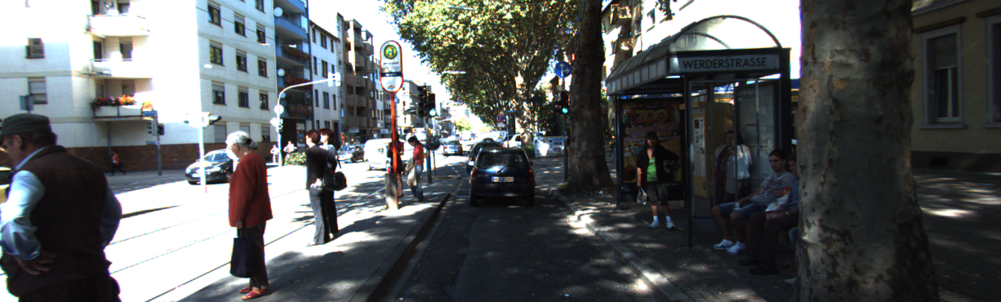
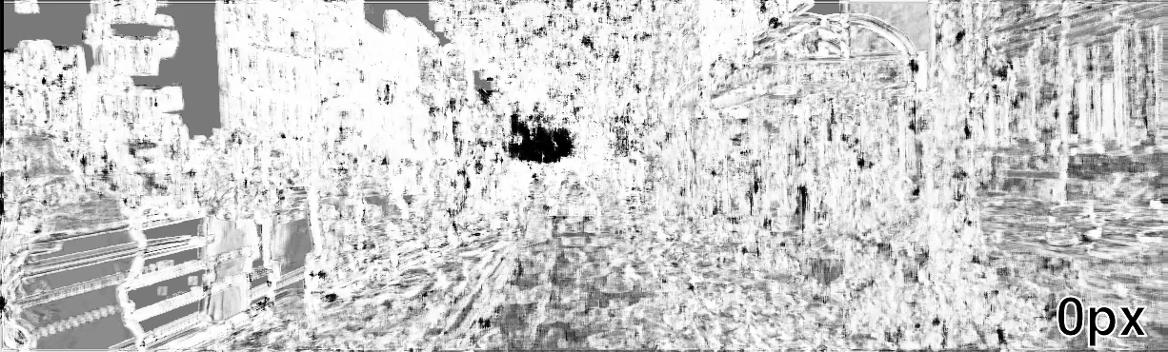
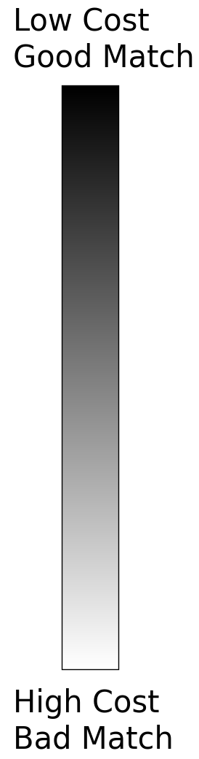
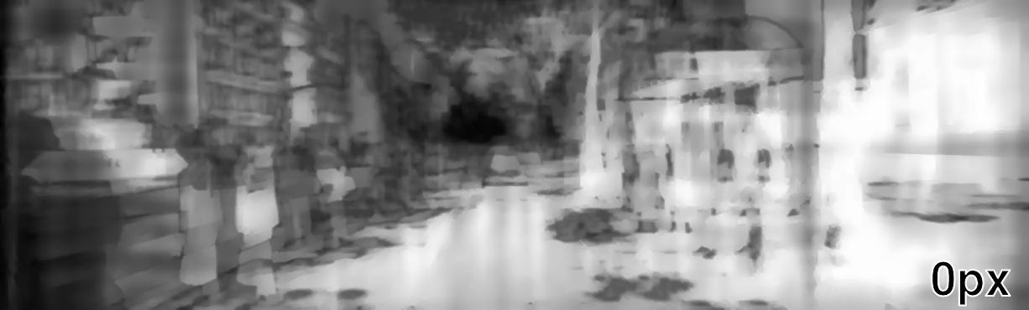
Results: Disparity Space Image
Left Image
DSI
after CNN
DSI after
Postprocessing
Input images from KITTI 2015 Dataset [17]

Slide 11
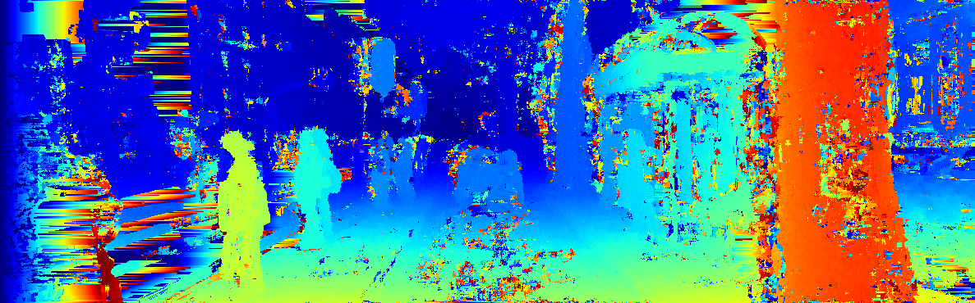
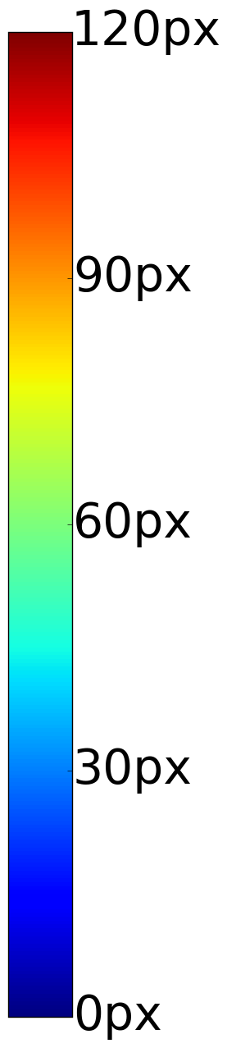
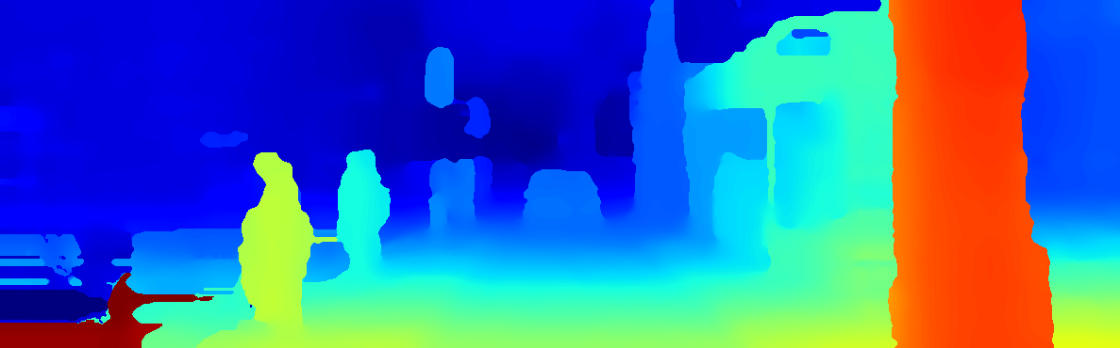
Results: Disparity Map
Left Image
Disparity
after CNN
Disparity after
Postprocessing
Input images from KITTI 2015 Dataset [17]

Slide 12
Results: KITTI 2012 Benchmark
State-of-the-Art Stereo and Optical Flow Benchmark
Autonomous Driving scenario
Ground-truth obtained using 3D LiDAR
Rank | Method | Out-Noc | Avg-Noc | Runtime | Environment
1 | MC-CNN-acrt [2] | 2.43% | 0.7px | 67s | GTX Titan X
2 | Displets [14] | 2.47% | 0.7px | 265s | > 8 core @ 3.0GHz
3 | MC-CNN [1] | 2.61% | 0.8px | 100s | GTX Titan
4 | PRSM [15] | 2.78% | 0.7px | 300s | 1 core @ 2.5GHz
5 | SPS-StFl [16] | 2.83% | 0.8px | 35s | 1 core @ 3.5GHz
KITTI 2012 [13] Ranking on Nov 5, 2015, 3px Threshold, All Pixels

Slide 13
Conclusions & Future Work
Entirely novel approach for matching cost computation
First method to introduce CNNs into stereo pipeline
Post-processing needed for competitive results
Top results in major stereo benchmarks
Large computational effort
Revised Journal Version
  Improved feature extraction
  Accurate and Fast network variants
Potential future work
  Multiscale approaches
  Larger training sets (synthetic ground truth data)

Slide 14
References
[1] Žbontar & LeCun: Computing the stereo matching cost with a convolutional neural network, CVPR 2015
[2] Žbontar & LeCun: Stereo Matching by Training a Convolutional Neural Network to Compare Image Patches, arXiv preprint arXiv:1510.05970
[3] Scharstein et al.: High-resolution stereo datasets with subpixel-accurate ground truth, GCPR 2014
[4] Hartley & Zisserman: Multiple View Geometry in Computer Vision, 2003
[5] Loop & Zhang: Computing rectifying homographies for stereo vision, CVPR 1999
[6] Scharstein et al.: A taxonomy and evaluation of dense two-frame stereo correspondence algorithms, SMBV Workshops 2001
[7] Sinha et al.: Efficient high-resolution stereo matching using local plane sweeps, CVPR 2014
[8] Zabih & Woodfill: Non-parametric local transforms for computing visual correspondence, ECCV 1994
[9] Kim et al.: Visual correspondence using energy minimization and mutual information, ICCV 2003
[10] Mei et al.: On building an accurate stereo matching system on graphics hardware, ICCV Workshops 2011
[11] Zhang et al.: Cross-based local stereo matching using orthogonal integral images, TCSVT 2009
[12] Hirschmüller: Stereo processing by semiglobal matching and mutual information, PAMI 2008
[13] Geiger et al.: Are we ready for autonomous driving? The KITTI Vision Benchmark Suite, CVPR 2012
[14] Güney et al.: Displets: Resolving stereo ambiguities using object knowledge, CVPR 2015
[15] Vogel et al.: 3D Scene Flow estimation with a piecewise rigid scene model. IJCV 2015
[16] Yamaguchi et al.: Efficient joint segmentation, occlusion labeling, stereo and flow estimation, ECCV 2014
[17] Menze & Geiger: Object scene flow for autonomous vehicles, CVPR 2015

Slide 15
Q&A Session

Slide 16
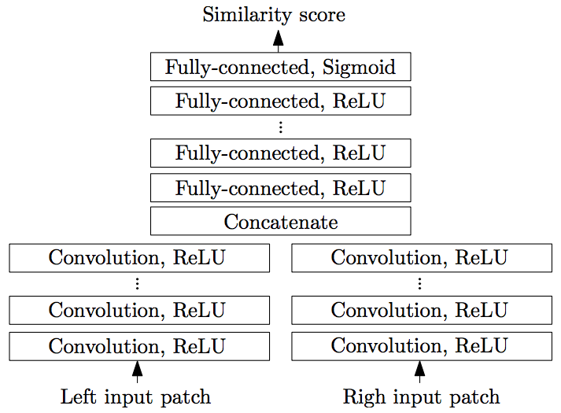
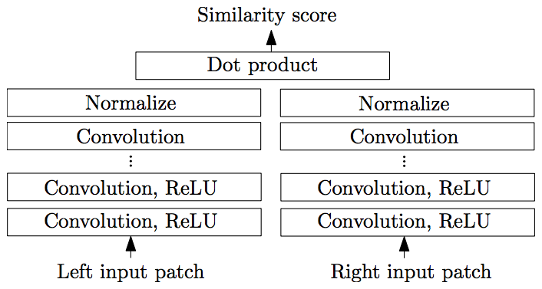
Revised Journal Architectures [2]
Accurate
Fast

Slide 17
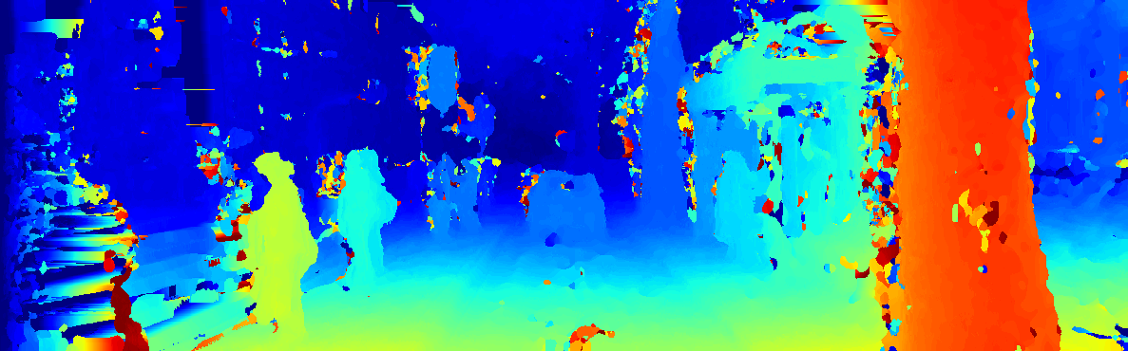
Postprocessing: Cross-Based-Cost-Aggregation
Left Image
Disparity
after CNN
Disparity after
CBCA
Input images from KITTI 2015 Dataset [17]

Slide 18
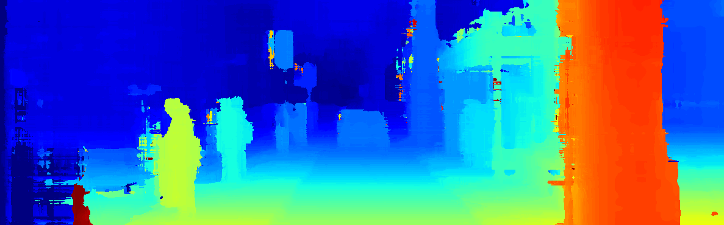
Postprocessing: Semiglobal Matching
Left Image
Disparity
after CBCA
Disparity after
SGM
Input images from KITTI 2015 Dataset [17]

Slide 19
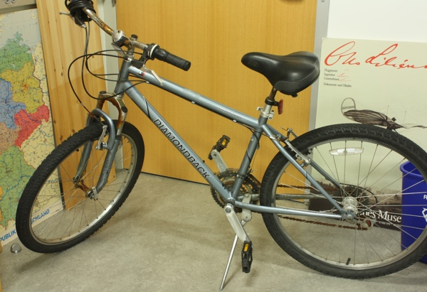
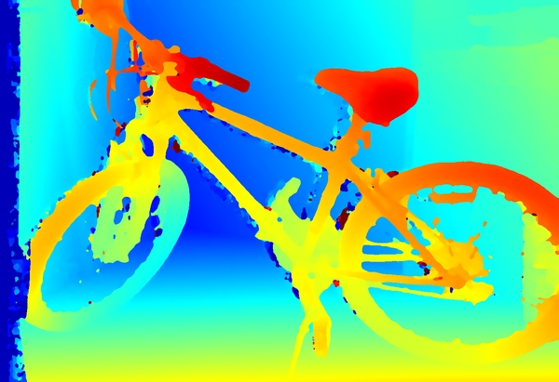
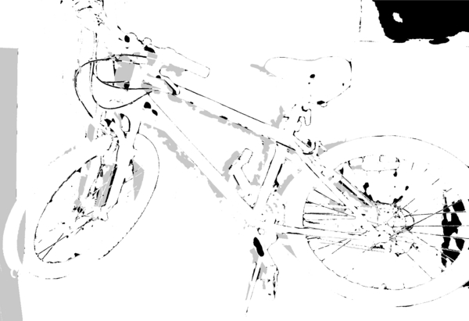
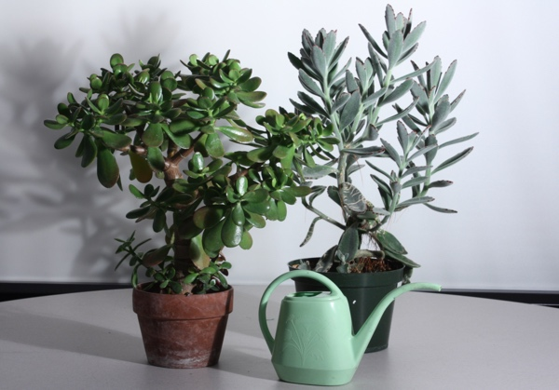
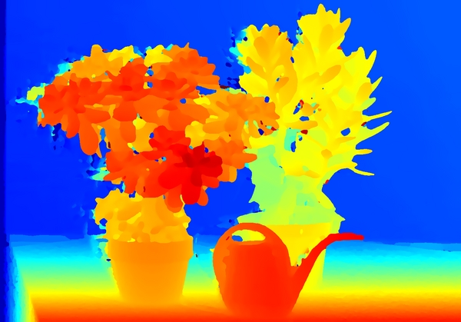
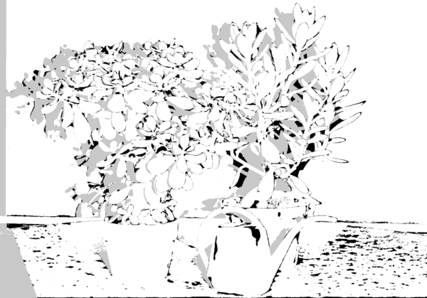
Middlebury 2014 Dataset [3] Results
Image
Disparity
bad 2.0 error

