Slide 1
Reducing the orthopedic risk of cycling with a vision-based scanner
Project Management and software development
Project Requirements Presentation
Mahdi Saleh

Slide 2
Problem Statement
Bicycle fit is essential
Comfort
Safety
Injury prevention
Peak performance
Overuse injuries develop over time
Average of 80 revolutions per minute
5400 revolutions during an hour
81,000 revolutions in the span of 1 week

Slide 3
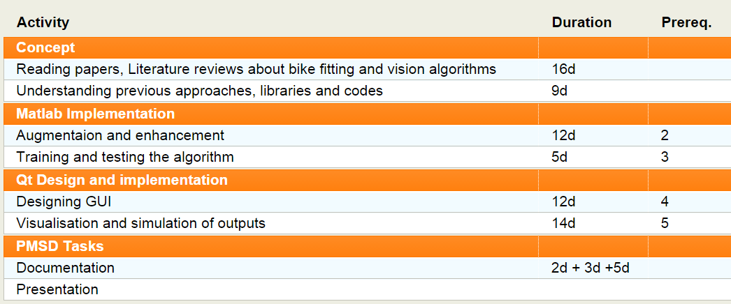
Gantt Chart

Slide 4
Gantt Chart

Slide 5
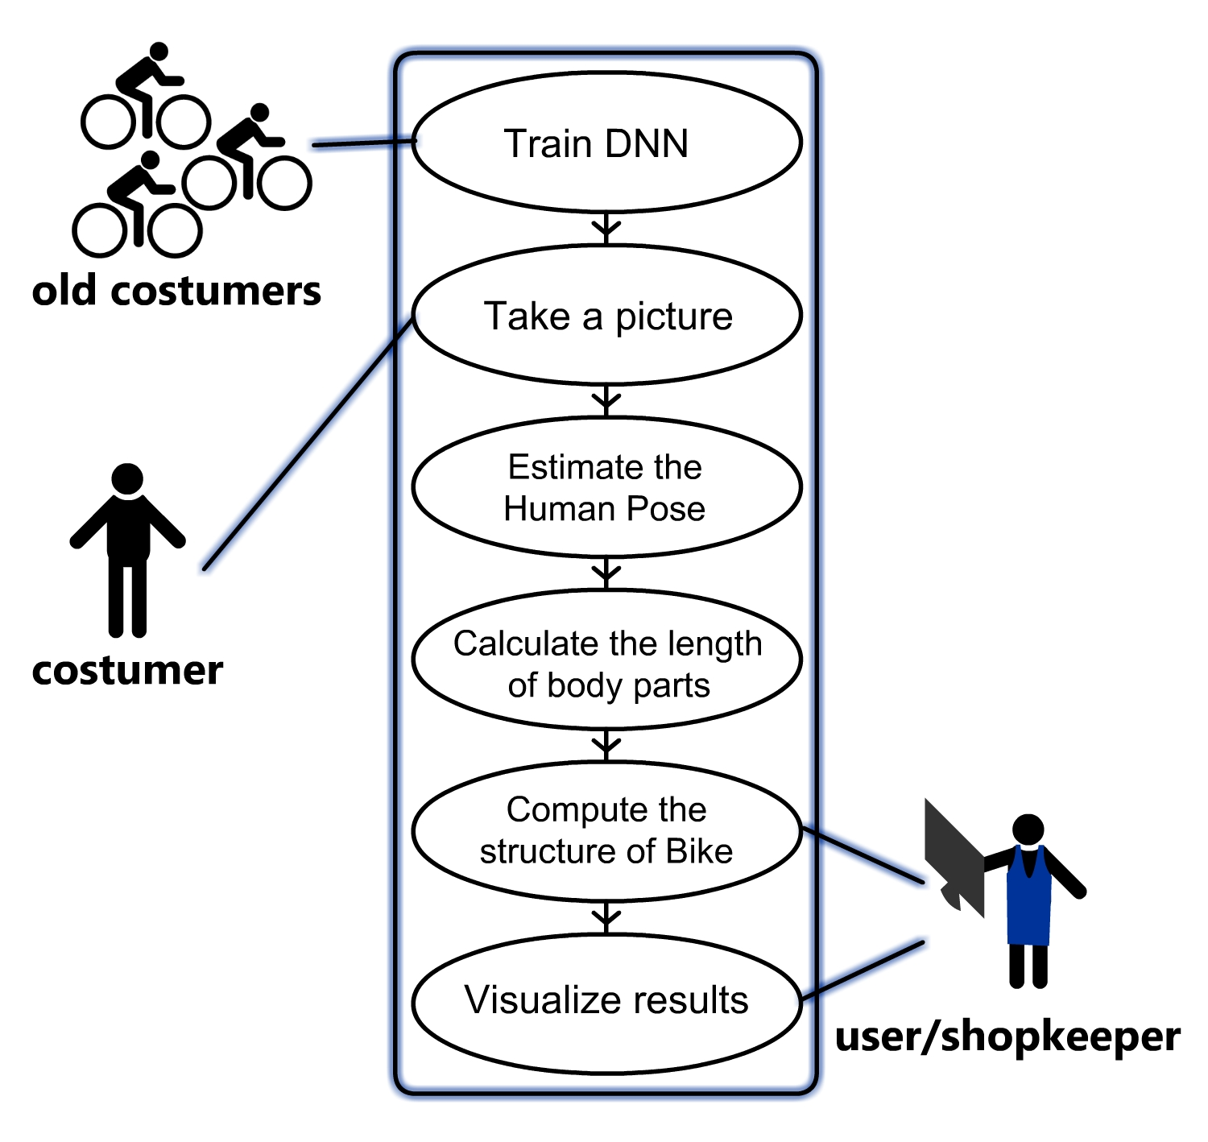
Use case Diagram

Slide 6
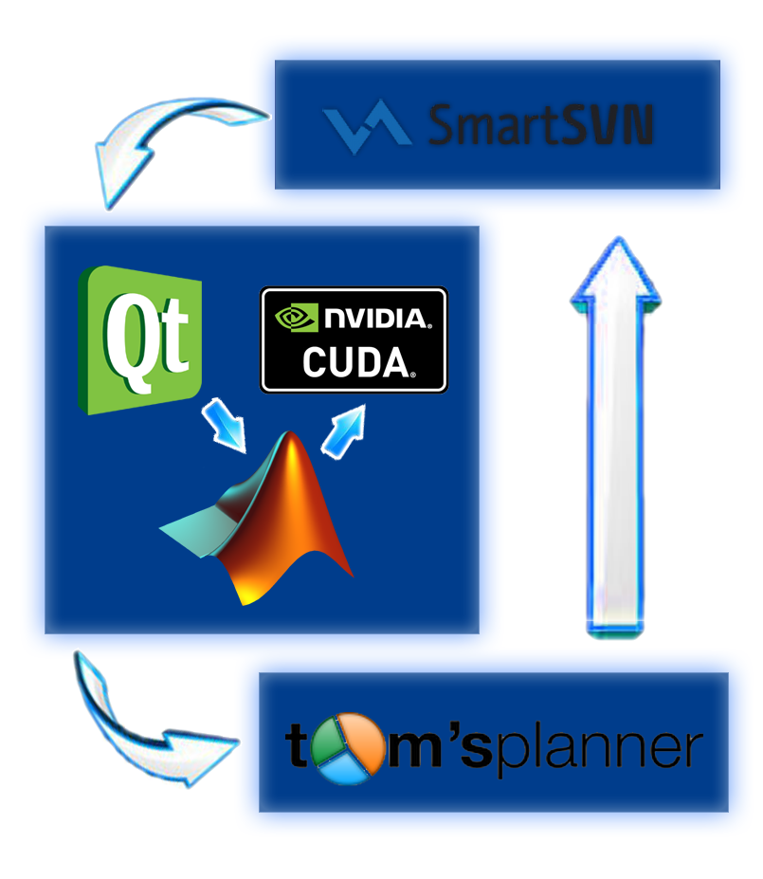
Software Requirements
Project Management
Tom’s Planner
Design and Implementation
Qt
Matlab
CUDA
Controling
SmartSVN

Slide 7
Considerations and important notes
Pose estimation robustness
Training data
Using better algorithms
DNN consideration
Using multiple frames
Fitting Considerations
Tables, Formulas
Constraints
Gender, age consideration

Slide 8
Thank you!

