Slide 1
Foundations of Computer Vision
Rapid object / face detection using a Boosted Cascade of Simple features
Presented by Christos Stoilas

Slide 2
Figure 1
Foundations of Computer Vision
Christos Stoilas

Slide 3
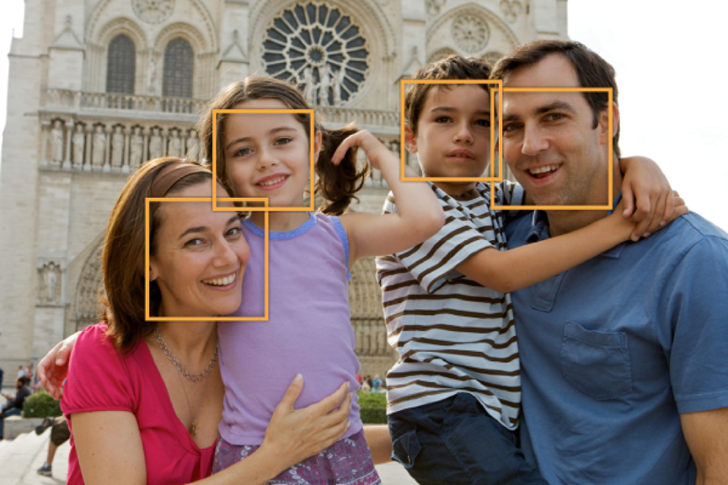
Overview
Introduction
Viola-Jones Framework
Features
Results
Conclusion
Integral Image
Boosting-Adaboost
Detector Cascade
Figure 2
Foundations of Computer Vision
Christos Stoilas

Slide 4
Overview
Introduction
Viola-Jones Framework
Features
Results
Conclusion
Integral Image
Boosting-Adaboost
Detector Cascade
Foundations of Computer Vision
Christos Stoilas

Slide 5
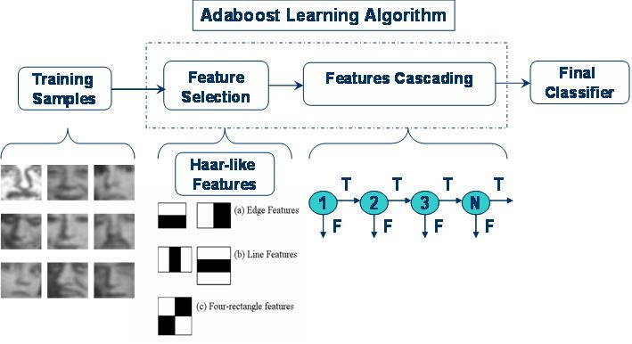
Viola Jones Framework
Goal: detecting faces extremely rapidly with high detection rates
Three contributions:
Integral Image fast feature evaluation
AdaBoost learning algorithm Constructing a strong classifier
Detector Cascade combining succesively more difficult classifiers in a cascade structure
Figure 3: Simple depiction of the framework
Foundations of Computer Vision
Christos Stoilas

Slide 6
Overview
Introduction
Viola-Jones Framework
Features
Results
Conclusion
Integral Image
Boosting-Adaboost
Detector Cascade
Foundations of Computer Vision
Christos Stoilas

Slide 7
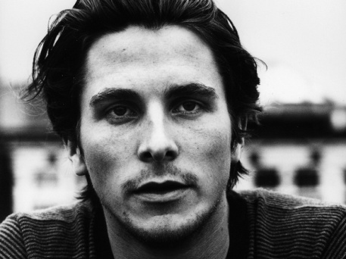
Features
Features: specific structures in images (points, edges, objects)
Three types of features:
Figure 4: a) two-rectangle feature
b) three-rectangle feature
c) four-rectangle feature
Figure 5:Photo of Christian Bale in greyscale
Value of feature = sum of pixels from grey rectangles – sum
of pixels from white rectangles
Foundations of Computer Vision
Christos Stoilas

Slide 8
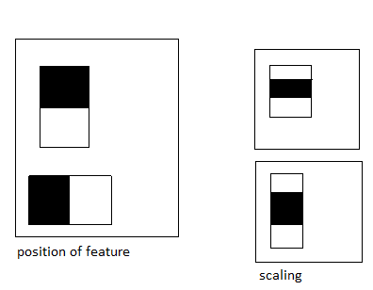
Features
Location and scaling of a feature: different positions and scales in the detection window
Number of rectangle features
in a 24x24 Pixel detection
window over 180.000
Figure 6
Why is the object detection procedure based on features and
not on pixels?
Foundations of Computer Vision
Christos Stoilas

Slide 9
Overview
Introduction
Viola-Jones Framework
Features
Results
Conclusion
Integral Image
Boosting-Adaboost
Detector Cascade
Foundations of Computer Vision
Christos Stoilas

Slide 10
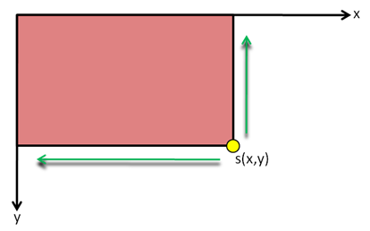
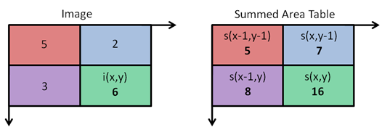
Integral Image / Summed Area Table
Problem:
Evaluation of a feature summing all the pixels one by one for one of these rectangles high computation time
Solution – Integral Images
Quick calculation of pixel sums within rectangular cutouts
The Summed Area Table at a point (x,y):
[1]
Figure 7: Integral image at
location (x,y)
Figure 8 : Original and integral image
Foundations of Computer Vision
Christos Stoilas

Slide 11
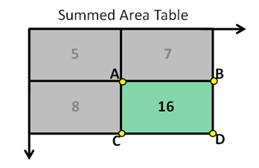
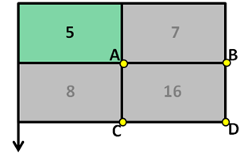
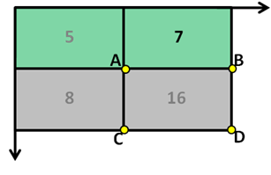
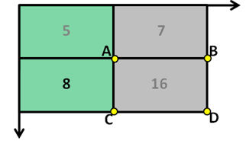
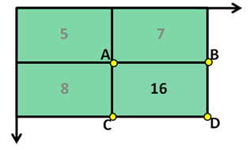
Integral Image / Summed Area Table
Calculating the sum of pixels in some rectangle can be done in constant time
The sum of the pixels within rectangle D
can be computed with four array
references:
[2]
Figure 9a: Value of s(D)
Figure 9b: Value of s(A)
Figure 9c: Value of s(A)+s(B)
Figure 9d: Value of s(A)+s(C)
Figure 9e: Value of s(A)+s(B)+(C)+s(D)
Foundations of Computer Vision
Christos Stoilas

Slide 12
Overview
Introduction
Viola-Jones Framework
Features
Results
Conclusion
Integral Image
Boosting-Adaboost
Detector Cascade
Foundations of Computer Vision
Christos Stoilas

Slide 13
Boosting
Offline procedure - improves the accuracy of a learning algorithm
Idea: select and combine a small number of weak classifiers to build a strong classifier reducing computation time
AdaBoost learning algorithm
Example image where 1 for negative and positive examples
Initialize weights
For t = 1,….,T
Normalize weights:
For each feature j, train a weak classifier using the weak learner. Evaluate the error
with respect to . . The classifier consists of a threshold
and a parity indicating the direction of the inequality sign:
{
1
0, otherwise
=
Foundations of Computer Vision
Christos Stoilas

Slide 14
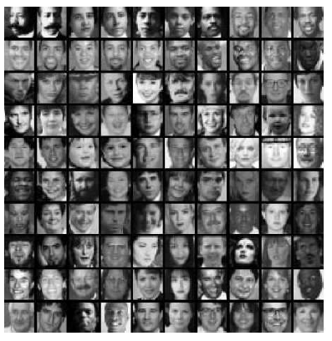
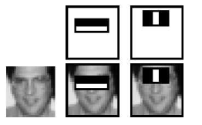
AdaBoost learning algorithm
Choose the classifier with the lowest error
Update the weights :
where if example image is classified correctly, otherwise
and , where
{
The final strong classifier: 1
0 otherwise
Figure 10b: Example of frontal upright face images used for
training
Figure 10a: Two rectangle features chosen by AdaBoost
Foundations of Computer Vision
Christos Stoilas

Slide 15
Overview
Introduction
Viola-Jones Framework
Features
Results
Conclusion
Integral Image
Boosting-Adaboost
Detector Cascade
Foundations of Computer Vision
Christos Stoilas

Slide 16
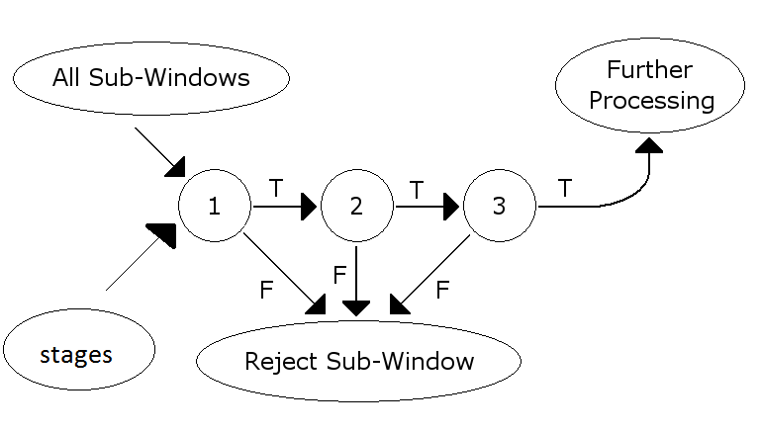
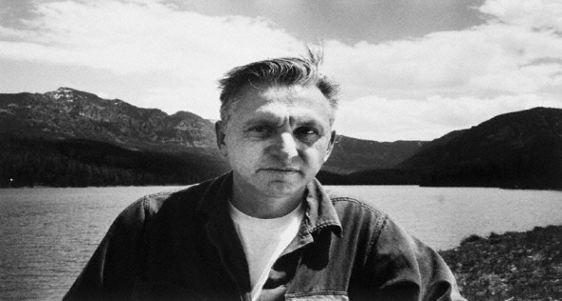
Detector Cascade
Combining increasingly more complex classifiers in a „cascade“
Goals
Achieving higher detection rates / Reducing the false rate
Reducing computation time
Figure 12: Non-face image
Figure 13: Image with a face-like object
Figure 11: Simple depiction of a detector cascade
Figure 14: Image with a face
Foundations of Computer Vision
Christos Stoilas

Slide 17
Overview
Introduction
Viola-Jones Framework
Features
Results
Conclusion
Integral Image
Boosting-Adaboost
Detector Cascade
Foundations of Computer Vision
Christos Stoilas

Slide 18
Results
Training 4916 images and their vertical mirror images
The detector cascade consisted of 38 stages with a number of 6061 features
MIT+CMU frontal face test set 130 images 507 frontal faces
15 times faster than any other previous approach
Figure 15: Detection rates for various numbers of false positives on the MIT+CMU test set containing 130 images and 507
faces.
Foundations of Computer Vision
Christos Stoilas

Slide 19
Overview
Introduction
Viola-Jones Framework
Features
Results
Conclusion
Integral Image
Boosting-Adaboost
Detector Cascade
Foundations of Computer Vision
Christos Stoilas

Slide 20
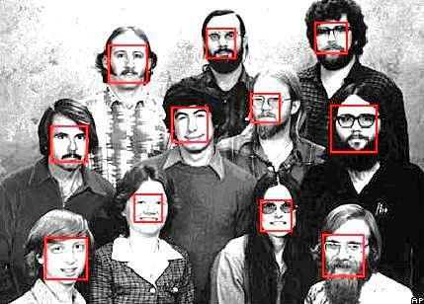
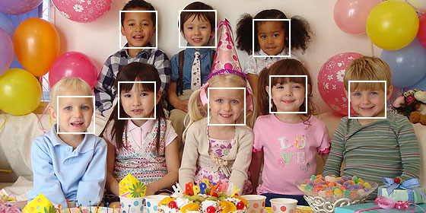
Conclusion
Object detection which minimizes computation time and with high detection accuracy
Detectors for other objects can be constructed in similar way
Framework based on a complicated detection dataset which includes faces under a very wide range of conditions like:
Illumination, scale, pose, camera variation
Figure 16
Figure 17
Foundations of Computer Vision
Christos Stoilas

Slide 21
Thank you for your attention!
Foundations of Computer Vision
Christos Stoilas

Slide 22
References
[1] „https://computersciencesource.wordpress.com/2010/09/03/computer-vision-the-integral-image“, Visited on
18.11.2014, Integral Image
[2] „https://computersciencesource.wordpress.com/2010/09/03/computer-vision-the-integral-image“, Visited on
18.11.2014, Integral Image
Figure 1: „http://www.richardnichols.net/2011/01/java-facial-recognition-haar-cascade-with-jjil-guide“, Visited on 18.11.2014
Figure 2: „https://developer.apple.com/library/ios/documentation/GraphicsImaging/Conceptual/
ci_detect_faces.html“, Visited on 19.11.2014
Figure 3: „http://utarcvis.blogspot.de/2007/09/robust-real-time-face-detection-by-paul.html“, Visited on 19.11.2014
Figure 5: „http://www.wall321.com/People/Actors/men_christian_bale_grayscale_actors_faces
_blurred_background_portraits_133480“, Visited on 19.11.2014
Figure 7, 8, 9 : „https://computersciencesource.wordpress.com/2010/09/03/computer-vision-the-integral-
image“, Visited on 18.11.2014, Integral Image
Figure 10, 15: P. Viola, M. Jones: "Rapid object detection using a boosted cascade of simple features". CVPR 2001, Visited on
08.11.2014
Figure 11: „http://en.wikipedia.org/wiki/Viola%E2%80%93Jones_object_detection_framework“, Visited on 22.11.2014
Figure 12: „http://www.hdwallsource.com/grayscale-35778.html/grayscale-35778“, Visited on 22.11.2014
Figure 13: „http://www.pickywallpapers.com/kindle3/movies-tvshows/ghostface-in-scream-s
creensaver/download“, Visited on 22.11.2014
Figure 14: „http://www.bartneck.de/page/7“, Visited on 24.11.2014
Figure 16: „http://people.kyb.tuebingen.mpg.de/kienzle/fdlib/fdlib.htm“, Visited on 24.11.2014
Figure 17: „http://stackoverflow.com/questions/15526964/face-recognition-using-android-sdk-not-opencv“, Visited on 24.11.2014
Foundations of Computer Vision
Christos Stoilas

