Slide 1
Reducing the orthopedic risk of cycling with a vision-based scanner
Project Management and software development
Project Requirements Presentation
Mahdi Saleh

Slide 2
Problem Statement from another view

Slide 3
Problem Statement from another view

Slide 4
Problem Statement from another view

Slide 5
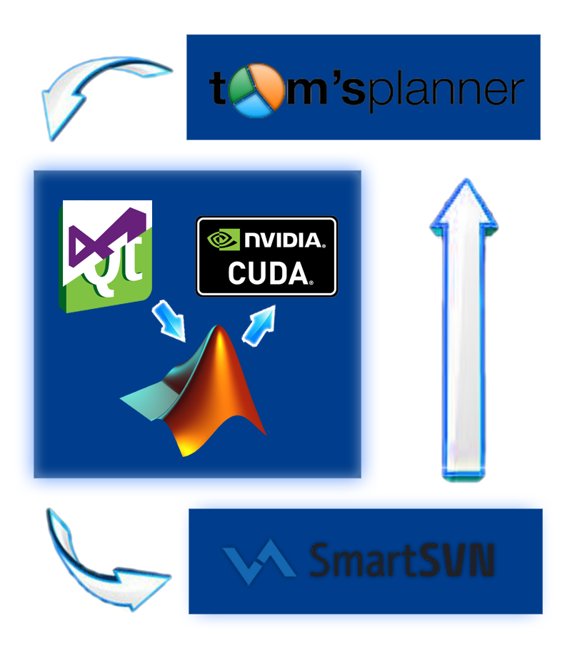
Software Requirements

Slide 6
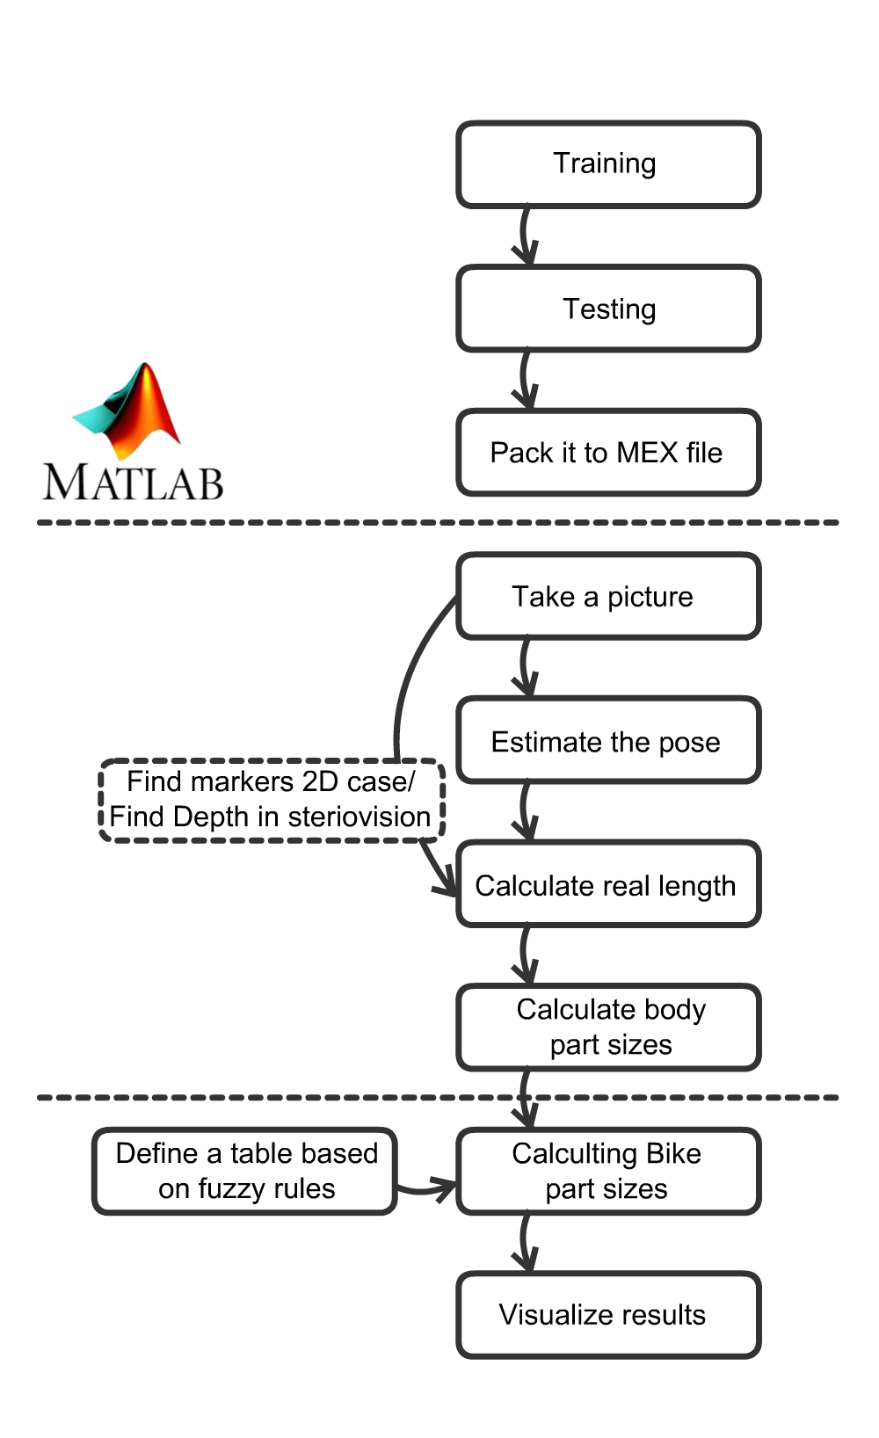
Procedure breakdown

Slide 7
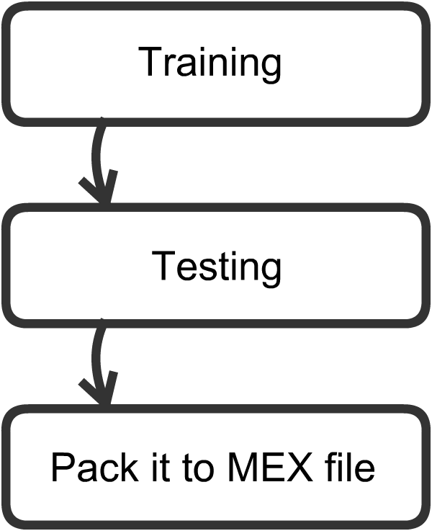
Offline Phase

Slide 8
Offline Phase
Training Data
Needs hundreds of Training set
Image sizes: 100*100
3-channel images
Using multiple frames
Deep network
Convolutional Neural Network
7 block stages
outputs a set of 3D vectors

Slide 9
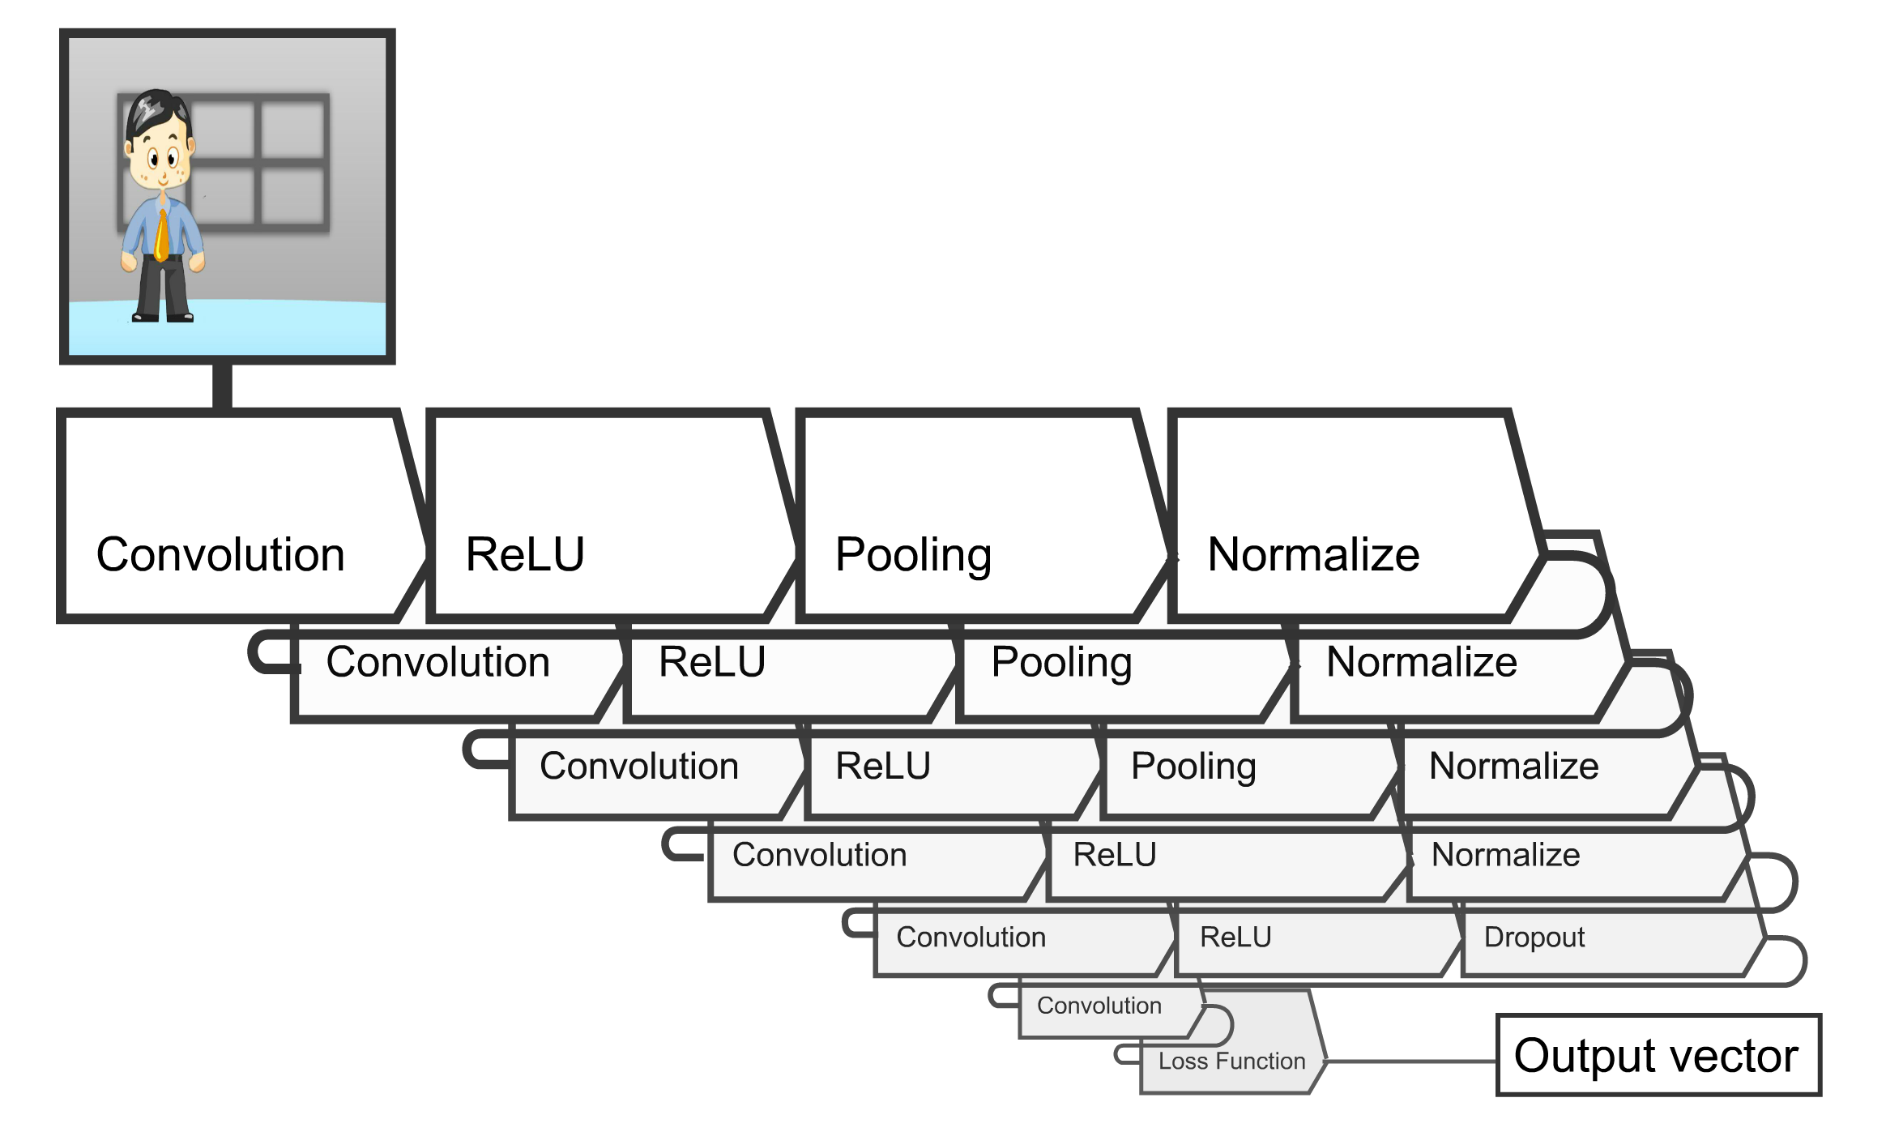
Convolutional Neural Network Structure

Slide 10
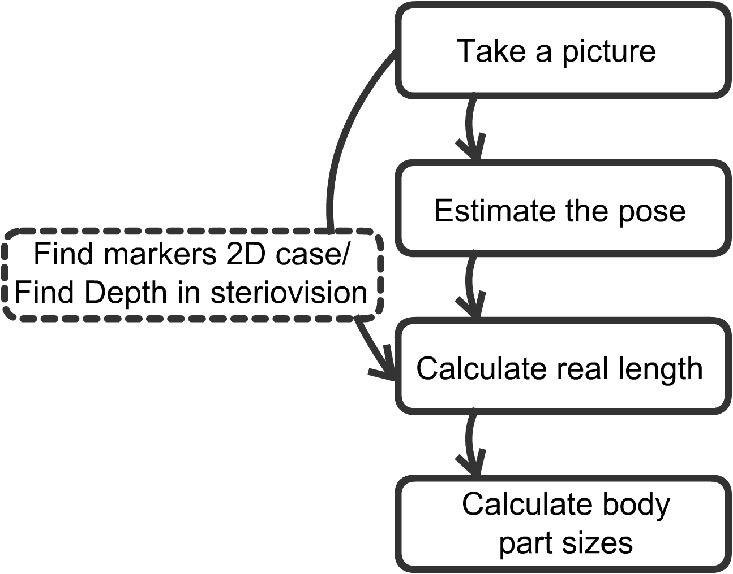
Computer vision tasks

Slide 11
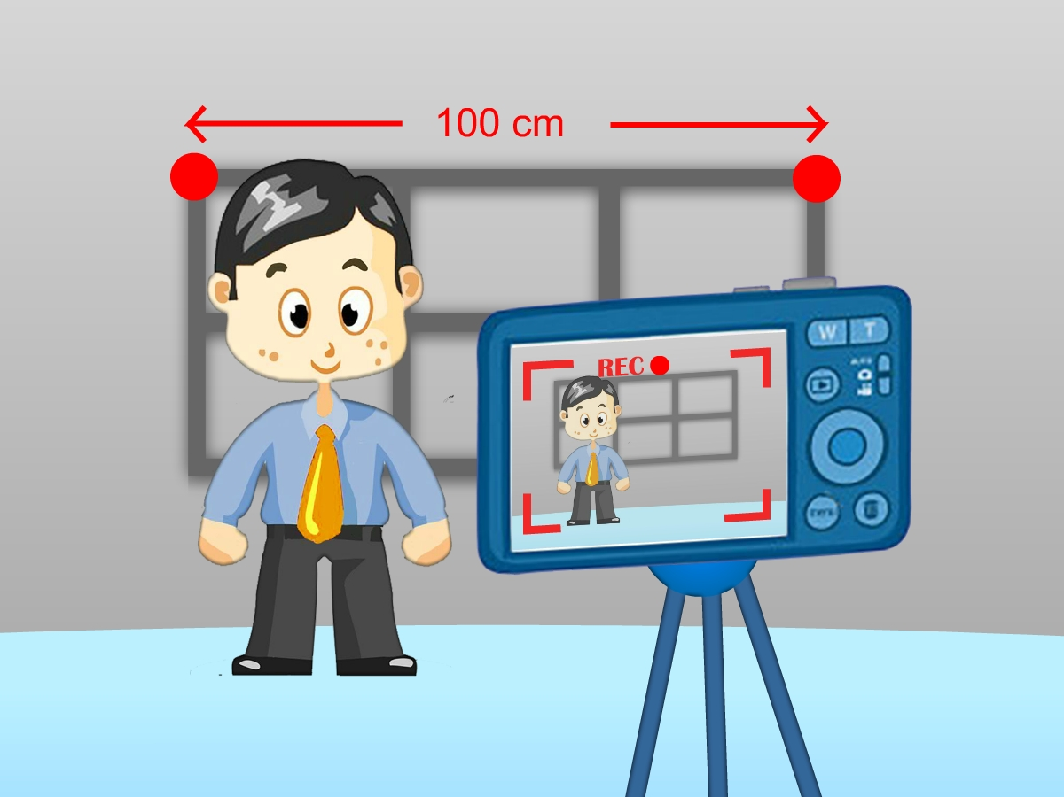
Computer vision tasks
Calculating body parts’ sizes
using Euclidean distance
we can use mean of several frames
Calculating real world lengths
Detecting two fixed markers
Using stereovision cameras

Slide 12
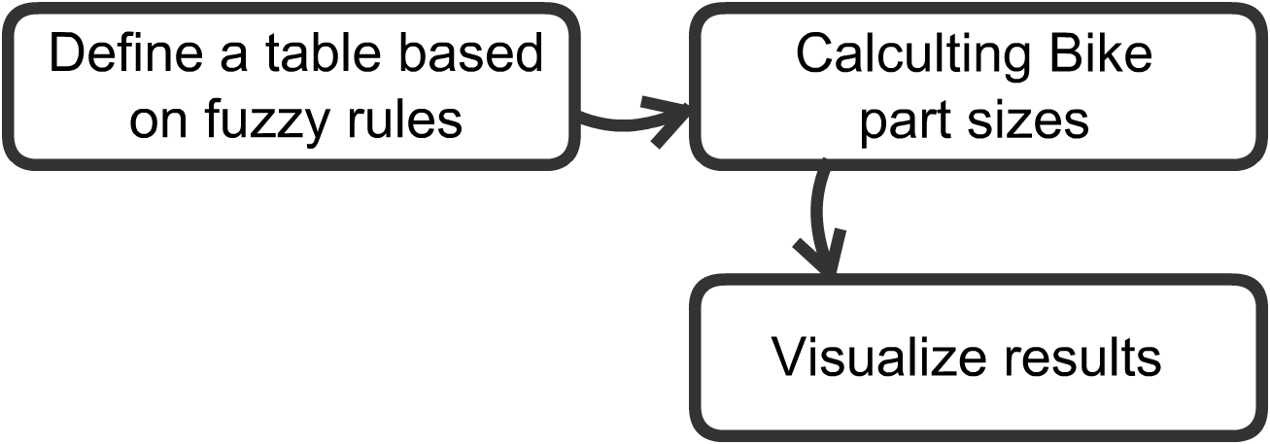
Bicycle relevant tasks

Slide 13
Bicycle relevant tasks
Location | Causes | Bicycle adjustment
Anterior | Seat too low | Raise seat
 | Seat too far forward | Move seat back
 | Climbing too much | Reduce climbing
 | Big gears, low rpm | Spin more
 | Cranks too long | Shorten cranks
Posterior | Saddle too high | Lower saddle
 | Saddle too far back | Move saddle forward
Baker A. Bicycling Medicine. New York : Fireside, Simon and Schuster, 1998.

Slide 14
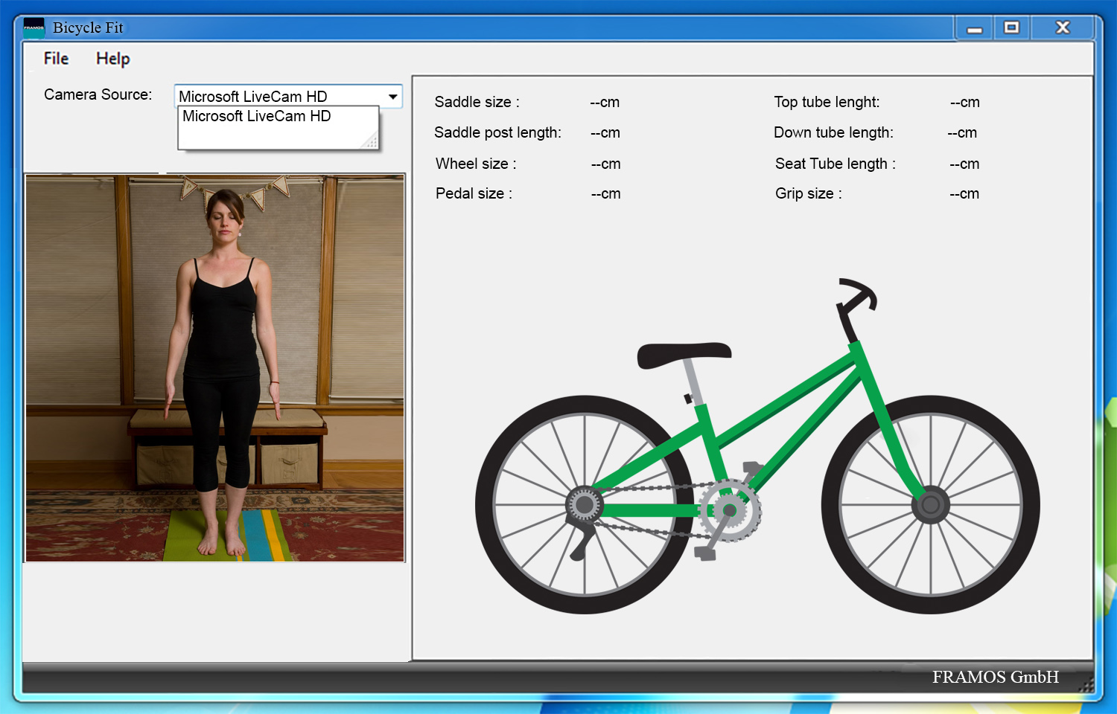
GUI Schema

Slide 15
Gantt Chart

Slide 16
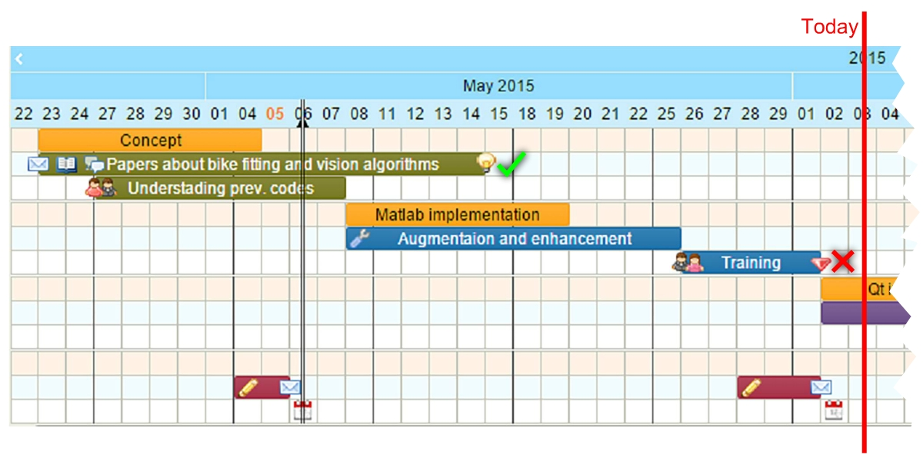
Project planning so far

Slide 17
Thank you!

